Slide 1
Outlook for the Gas Compression Industry
GCA Fall Meeting
October 2018
Spears & Associates
Tulsa, OK

Slide 2
US Gas Market
US Gas Production
Continues to set new records
2.5% CAGR since 2006; reached all-time highs 9 of the past 11 years
81.1 bcfd in 2018 (up 10%) due to gas plays and associated gas from oil shales
2.9% CAGR to 2023
Need to expand midstream infrastructure to handle future shale production growth
“Rolling” takeaway capacity constraints
Spears & Associates
Notes:
For Richard

Slide 3
US Gas Market
Permian Midstream
Four likely/identified gas pipeline projects – Gulf Coast Express, Old Ocean Restart, Oasis Expansion, WesTex Expansion (I). Seven takeaway projects under consideration
30 processing plants currently under construction or announced. All expected to be in service by the end of 2019. Up to 10 additional processing plants needed in the Midland basin.
Marcellus/Utica Shale Midstream
8 processing plants under construction or announced. All expected to be placed in service by the end of 2019. Up to 20 additional processing plants needed.
Bakken Midstream
5 processing plants are under construction; all expected to be in service by the end of 2019.
SCOOP/STACK Midstream
10 processing plants currently under construction or announced. All expected to be in service by the end of 2019. Up to 8 additional processing plants needed.
Spears & Associates

Slide 4
US Gas Market
US Gas Consumption Outlook
Underwhelming; projected to grow at a ~1% CAGR with growth to come from the industrial (petrochemical) sector
Gas-fired power plants supplied 37% of US electricity generation this summer, an all-time high
Power sector CAGR (2007-2017): -0.3%
Spears & Associates

Slide 5
US Gas Market
US Gas Export Outlook
Expected to remain robust; US gas exports forecast to jump 33% in 2019 to 13.4 bcfd
LNG exports projected to average 5.1 bcfd next year, up 70%. Minimal impact of Chinese tariff surcharge on US LNG exports
Pipeline exports projected to average 8.3 bcfd in 2019, up 17%
Spears & Associates

Slide 6
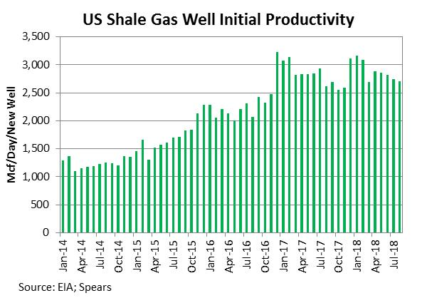
US Gas Market
Shale Well Productivity
Overall US shale well initial productivity has stopped rising for gas production, following a three-year period when productivity increased at an average rate of ~50% per year
IP continues to rise in the Permian Basin and Eagle Ford but this is offset by declines in other regions
Spears & Associates

Slide 7
US Gas Market
Spot Gas Prices
Long-term prices expected to average ~$2.50/mmbtu as gas supplies look to remain plentiful
“Zero bid” pricing could temporarily emerge in the next 12-24 months where midstream capacity proves insufficient to handle rapidly-growing volumes of associated gas
Spears & Associates

Slide 8
Global Oil Market
Global Oil Market Outlook
Demand forecast to average 101.3 million bpd in 2019, up 1.3%
Emerging markets (53% of global oil demand) – economic growth and oil demand negatively impacted by the strong dollar
Production outside North America to see little growth to 2023
US to supply 60%-80% of incremental global demand growth over the near- and mid-term
~8% CAGR for US oil production
Spears & Associates

Slide 9
US Oil Market
US Crude Oil Production Outlook
Average of 11.4 million bpd in 2019 (up 0.8 million bpd, or 8%)
The midstream sector has mobilized so quickly to address the Permian pipeline situation that the outlook has shifted from that of 2018 takeaway bottlenecks to a 2020 overbuild scenario, providing a runway for crude production growth from the Permian into the next decade
Spears & Associates

Slide 10
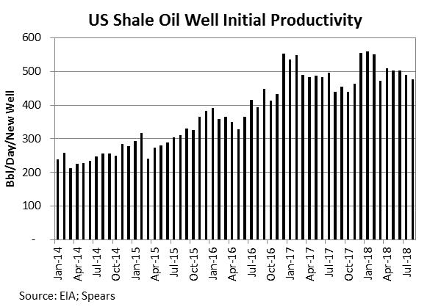
US Oil Market
Shale Well Productivity [“month 1” oil production for US shale wells]
Shale well initial productivity for oil production improved steadily over the 2014 to 2016 timeframe, but has trended flat-to-lower since the start of 2017 – in every major shale play
Well quality has deteriorated as activity has increased, more than enough to offset gains from longer laterals and improved completion techniques
As IP comes down, ever-more drilling is required to replace lost production
Spears & Associates

Slide 11
Global Oil Market
Oil Prices
Long-term outlook for WTI at $75/bbl, +/- $10/bbl
Geopolitical supply concerns - Iranian sanctions/Venezuelan output collapse
Brent-WTI discount to shrink as Permian takeaway constraints are eliminated
Operators expected to base 2019 budgets on current futures strip ($60-$65)
Spears & Associates

Slide 12
Drilling Activity
US
Overall US rig activity forecast to increase 8% from 2018 to 2023
Expected to rise 17% this year and 3% in 2019
Drilling activity in the Permian expected to trend higher as even as completion activity slows
Concerns about future access to high-spec drilling rigs
Spears & Associates

Slide 13
Drilling Activity
US
The number of new US wells drilled forecast to increase 10% from 2018 to 2023
Oil and gas well count projected to increase 11% in 2018 to ~20,300 and 5% in 2019 to ~21,500
Spears & Associates

Slide 14
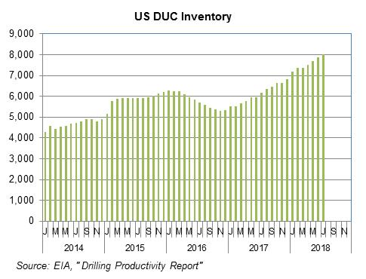
Completion Activity
US
While the Permian completion market looks challenging for the next ~12 months, signs point toward a sharp turnaround in completion activity beginning in H2’ 19
The keys are two-fold: the amount of new pipeline capacity coming onstream, and the size of the “fracklog”
Permian pipeline capacity will grow from 3.5 million bpd as of mid-2018 to 4.0 million bpd as of mid-2019 and 6.0 million bpd by the start of 2020
If Permian drilling activity holds steady over the balance of this year and next and Permian completion activity declines 20% in order to match production growth with pipeline capacity, the Permian fracklog will double to ~7,000 wells at the end of 2019
We expect Permian completion activity to accelerate starting in the second half of 2019 as pipeline capacity comes onstream
The next bottleneck will be frac crews/equipment
Spears & Associates

Slide 15
Drilling Activity
International
Projected to increase 4% next year to 1,220 active rigs and over 17,500 new wells drilled
While project costs have come down, multi-year development timeframes remain common
Investors - wary that climate change initiatives will result in stranded assets – prefer short-cycle over long-cycle projects
Oil companies – still willing to invest in gas exploration/development
Spears & Associates

Slide 16
Commercial Trends
Compressor Fleet
Estimated to currently stand at ~65 million HP
Forecast to grow at 3% CAGR to 2023, in line with global gas demand growth
US market currently being driven by gas-lift, gathering and processing applications
Global compressor packaging expenditures expected to total ~$4.0 billion in 2019, up 10%.
Spears & Associates

Slide 17
Commercial Trends
Contract Compression Services
Rental ~20% of US fleet; ~17% of global fleet
Trend toward outsourced compression in the US market
Contract compression market expected to total $3.4 billion in 2019, up 7%
Spears & Associates

Slide 18
Summary
Capex discipline and cost management continue to be the key challenge for operators
The goal to relentlessly drive costs out of the system
Horizontal drilling/hydraulic fracturing will be the primary methods used by North American operators to manage cost and geological risk
“Big data” will be used to drive process optimization and efficiency gains. Production operations are likely the first area impacted
Optimizing resource recovery from gas shale/tight oil formations will be key over the mid- to long-term horizon
The US completion market will be challenging between now and summer 2019, but the post-2019 outlook for the US upstream sector is very positive
Spears & Associates

Slide 19
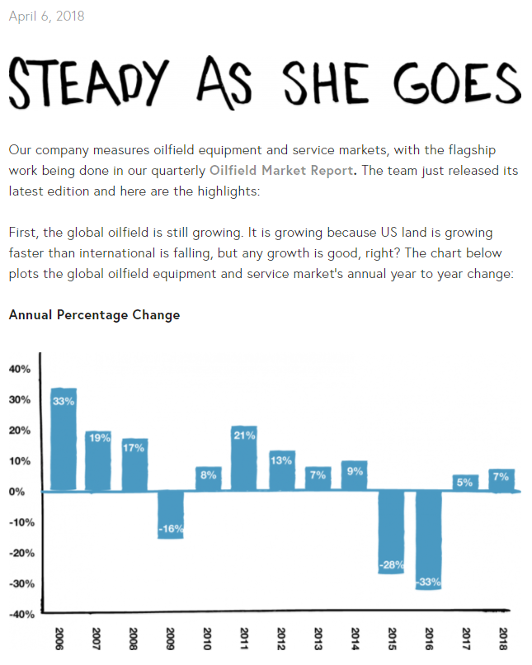
spearsresearch.com/insider/
Weekly Podcast
Video Series
Weekly Analysis
Free content on the Spears & Associates website
Spears & Associates

