Slide 1

Area Classifications Explained
GCA Expo 2018 – Galveston, Texas

Slide 2

Why do we care about hazardous areas?
GCA Expo 2018 – Galveston, Texas

Slide 3
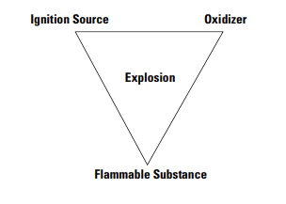
What leads to a hazardous situation?
GCA Expo 2018 – Galveston, Texas
Credit: Rockwell

Slide 4
Outline
GCA Expo 2018 – Galveston, Texas
Hazardous Area Classification Systems
  Class & Division System
  Zone Systems
  Temperature Codes for Hazardous Areas
  North American NRTLs
  Local AHJ
Techniques for Meeting Required Classifications
  Enclosure Systems
  Non-incendive & Intrinsically-safe Circuits
  Typical Protection Techniques
  End-devices & Sensors
  Wiring Practices & Certified Solutions
Maintaining Compliance
  Systemic Certifications & Interchangeability
  Other Considerations
Notes:
1. What is it
2. Who over sees itEnclosure
3. International differences and similarities
4. How we do it
A. Components
B. Panel systems
5. Others
6.Even though the panel may be C1D2 other items on the unit may not be
A. Exhaust systems
B ignition
C. Turbos
7. One change inside a panel and undo everything.

Slide 5
Class & Division Classification System
GCA Expo 2018 – Galveston, Texas
Class & Division Classification System
  Most commonly used in gas compression due to heavy NA influence
  Class 1, Division 2, Group C & D frequently seen
  Well harmonized between NEC & CEC

Slide 6
Zone Classification System
GCA Expo 2018 – Galveston, Texas
Zone Classification System
  Most commonly used outside North America
  Zone 2 IIA/IIB frequently seen in gas compression
  Many international standards based on IEC code – ATEX, etc.
  North American Zone system semi-compatible with IEC

Slide 7
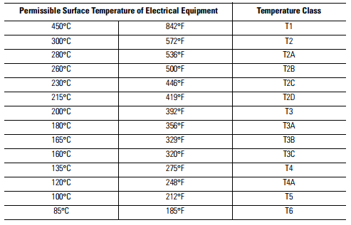
Temperature Codes for Area Classification
GCA Expo 2018 – Galveston, Texas
Credit: Rockwell

Slide 8
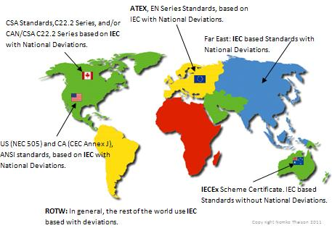
Global Standards – Many Regionalizations
GCA Expo 2018 – Galveston, Texas

Slide 9






Nationally Recognized Testing Laboratories (NRTLs)
GCA Expo 2018 – Galveston, Texas

Slide 10
The Authority Having Jurisdiction (AHJ)
GCA Expo 2018 – Galveston, Texas
In the National Electrical Code (NEC), the term Authority Having Jurisdiction (AHJ) is defined as “An organization, office, or individual responsible for enforcing the requirements of a code or standard, or for approving equipment, materials, an installation, or a procedure.”
The Authority Having Jurisdiction
  The final authority for enforcing the relevant codes and standards
  The AHJ may require additional requirements
  The AHJ can act as a “tie breaker” or help interpret codes as they apply in certain circumstances – i.e. battery boxes, etc.

Slide 11
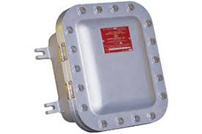
Enclosure Systems
GCA Expo 2018 – Galveston, Texas
Explosion-proof Enclosures
  Able to contain any explosion, spark, or flame inside of enclosure
  Allows for installation of general purpose equipment in hazardous areas

Slide 12
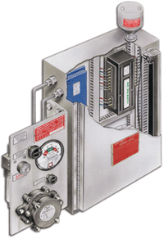
Enclosure Systems
GCA Expo 2018 – Galveston, Texas
Purged Enclosure Systems
  Use instrument air or inert gas to prevent hazardous area in enclosure
  Complex, costly, solution generally reserved for specialized applications

Slide 13
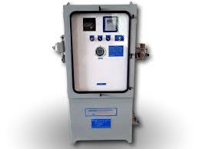
Enclosure Systems
GCA Expo 2018 – Galveston, Texas
Standard Enclosures
  Rated equipment typically carries the need for “suitable” enclosure
  Typically 3R, 12, or 4 NEMA type enclosure
  Used when appropriately rated equipment is installed
  Very typical for our industry

Slide 14
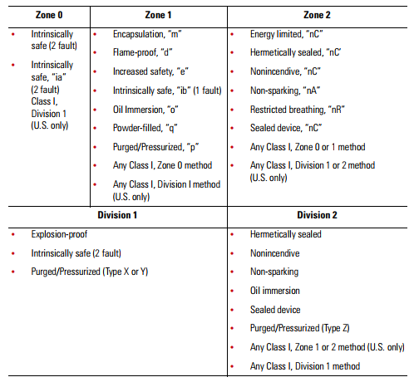
Typical Protection Techniques for Hazardous Areas
GCA Expo 2018 – Galveston, Texas
Credit: Rockwell

Slide 15
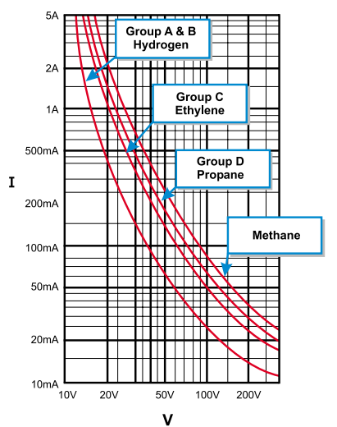
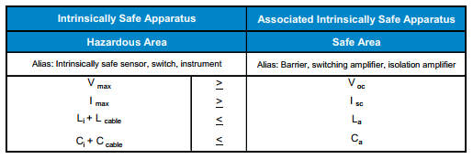
Non-incendive & Intrinsically-safe Circuits
GCA Expo 2018 – Galveston, Texas
Credit: TURCK

Slide 16
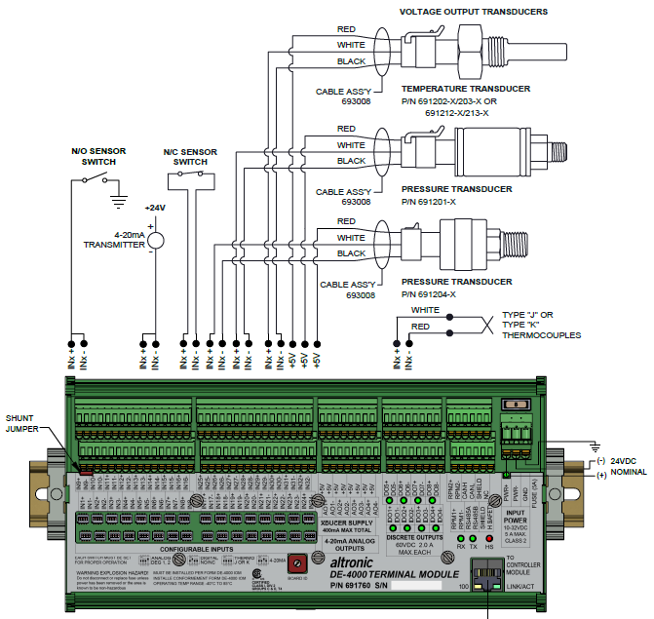

Non-incendive & Intrinsically-safe Circuits
GCA Expo 2018 – Galveston, Texas

Slide 17
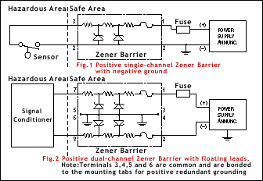
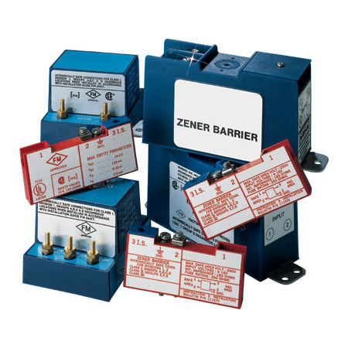
Non-incendive & Intrinsically-safe Circuits
GCA Expo 2018 – Galveston, Texas
Credit: OMEGA Engineering

Slide 18
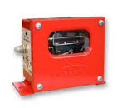
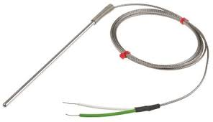
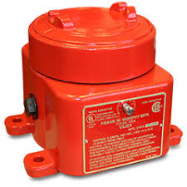
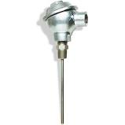
End-devices & Sensors
GCA Expo 2018 – Galveston, Texas
Passive End-devices
  Devices like switches & thermocouples with no active components
  Connected to non-incendive input vs. other sensor supply
  Enclosures from typical “standard” area type devices, to EX-proof enclosures

Slide 19
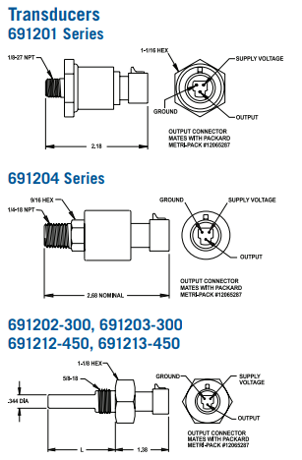
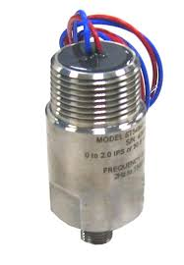
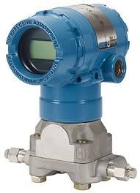
End-devices & Sensors
GCA Expo 2018 – Galveston, Texas
Powered Sensors & Transmitters
  Sensors can be certified non-incendive as part of a system – i.e. Altronic pressure and temperature sensors
  Certified sensors can also be rated for C1D2 or C1D1 areas as appropriate

Slide 20

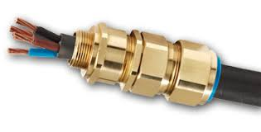
Wiring Practices & Certified Solutions
GCA Expo 2018 – Galveston, Texas
Accepted Wiring Practices for Class 1, Division 2 areas
  IMC/RMC/Flexible conduit and seal fittings – most popular in N.A.
  Tray cables (Type TC, PLTC, TC-ER, etc.) and gland fittings – very popular outside of N.A. – growing in popularity domestically
  Mechanical protection and prevention of gas migration top priority – non-incendive and intrinsically-safe circuits don’t require specialized wiring

Slide 21
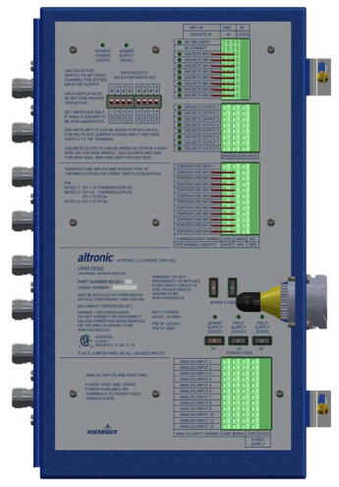
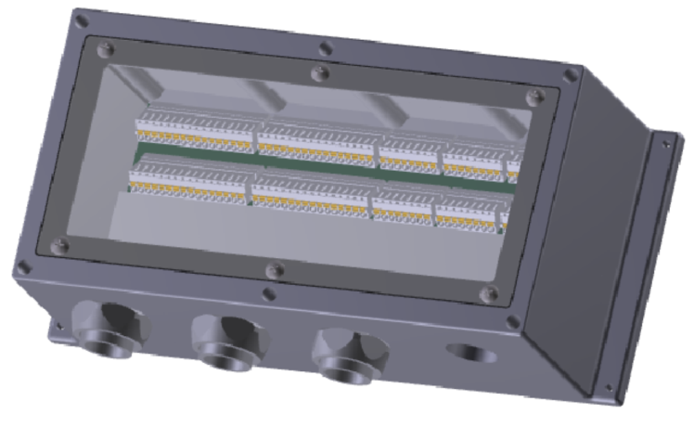

Wiring Practices & Certified Solutions
GCA Expo 2018 – Galveston, Texas
Certified Wiring & Sensor Solutions for Hazardous Areas
  Sensor interfaces like the USM system and others
  Distributed control systems
  Factory certified wiring solutions

Slide 22
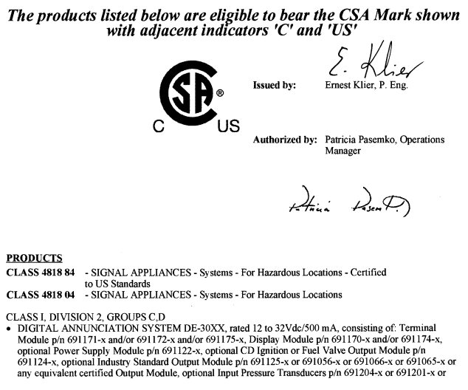
Systemic Certifications & Interchangeability
GCA Expo 2018 – Galveston, Texas

Slide 23
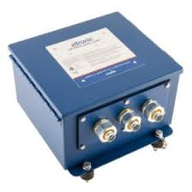
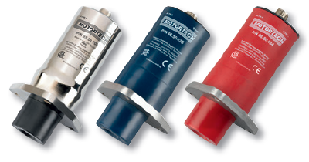

Systemic Certifications & Interchangeability
GCA Expo 2018 – Galveston, Texas
Substitution of components with “will-fit” usually voids Classification
  Substitution of components like ignition coils, relays, output modules, etc.
  Always be sure to use appropriate components that match manufacturers certification documents

Slide 24
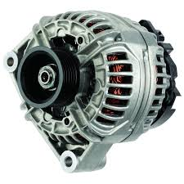
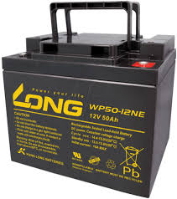
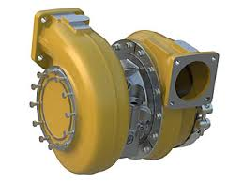
Other Considerations
GCA Expo 2018 – Galveston, Texas
The typical compressor package has other components that need to be considered in relation to hazardous areas
  Hot surfaces such as exhaust components, etc.
  Potentially arcing sources such as alternators and electric starters

Slide 25
Final Thoughts
GCA Expo 2018 – Galveston, Texas
Area classifications are complex, ever evolving, standards that require careful review for the application at hand
Additional consideration for global standards must take place for equipment being used outside of North America
Purpose-built products for the gas compression market offer a tailored approach that meets the requirements for area classification without excessive cost
Questions?

Slide 26

ENGINE DIVISION

