Slide 1
Common Failures in the Field: Recommendations for Avoiding Downtime, Machine Damage & Injury
Alison Mackey
Baker Hughes, a GE Company

Slide 2
Introduction
State of the Industry
Predictive Analytics Overview & Case Studies
Building a Digital Asset Management Program
Agenda

Slide 3
Introduction
Connecting Digital
Other Benefits
Increasing capital efficiency & profitability
Decrease Operating Cost
Manage Resources
Knowledge gap closure
Competitive advantages
Automation
Notes:
Enhancing productivity – maximizing recovery, improving equipment reliability, identify hidden productivity gains, minimize downtime & extend asset life
Reducing Operational Complexity – issuing recommendations to decrease overall parts & labor costs, provide analysis over fleets or groupings of equipment
Improve resource utilization – inventory management, online parts ordering, increased access to information with digitized manuals

Slide 4
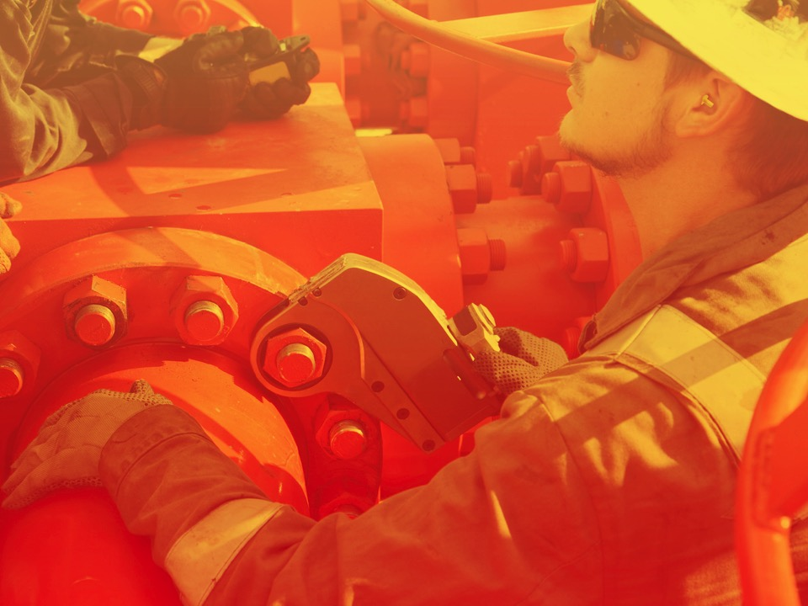
State of the Industry

Slide 5
State of the Industry
What drives demand for digital?
Aging Resources
Market Downturn
Data Demand
40% of O&G production comes from wells that are 25+ years old
Existing field optimization is key
Do more with less
Searching for opportunities to become more efficient
Global demand for data in every aspect
Bottom line boosts from digital

Slide 6
How do we get there?
Solutions should have three main characteristics…
Modular
Scalable
Autonomous
No one-sized-fits-all approach
Modular does not equal complicated
Single source of truth
What data gives the most value?
Systems should REDUCE workload
Set it and forget it

Slide 7
Predictive Analytics Overview

Slide 8

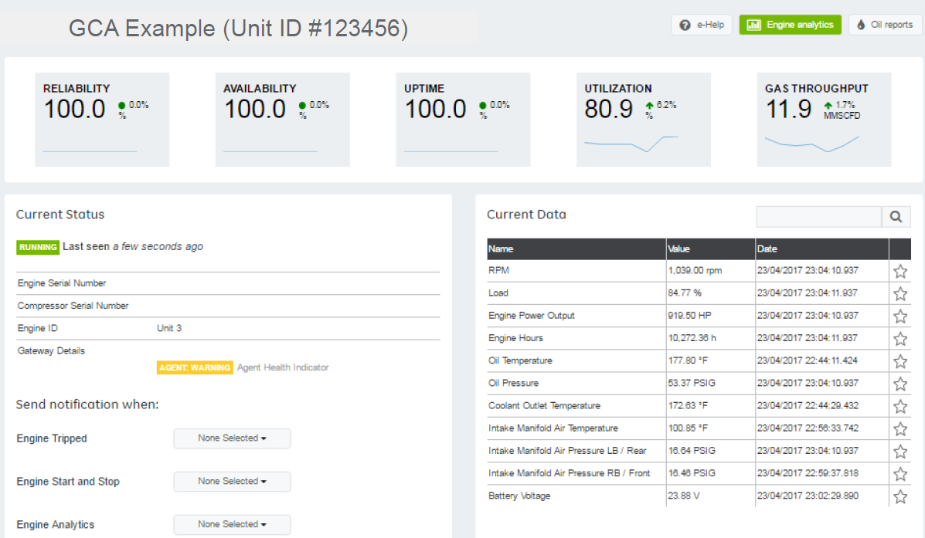

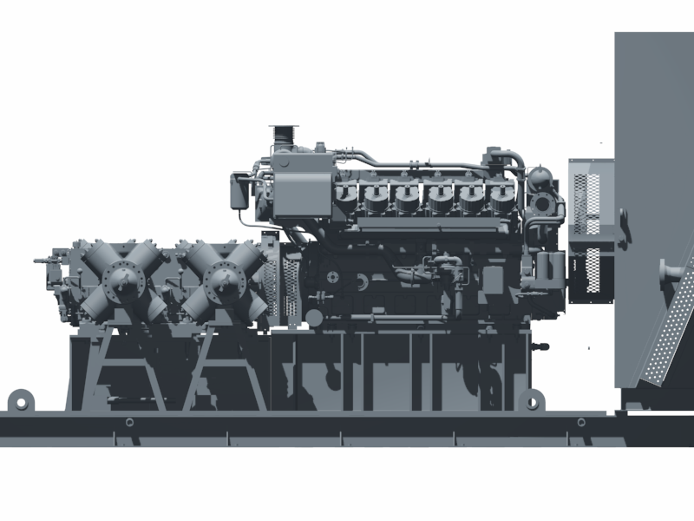
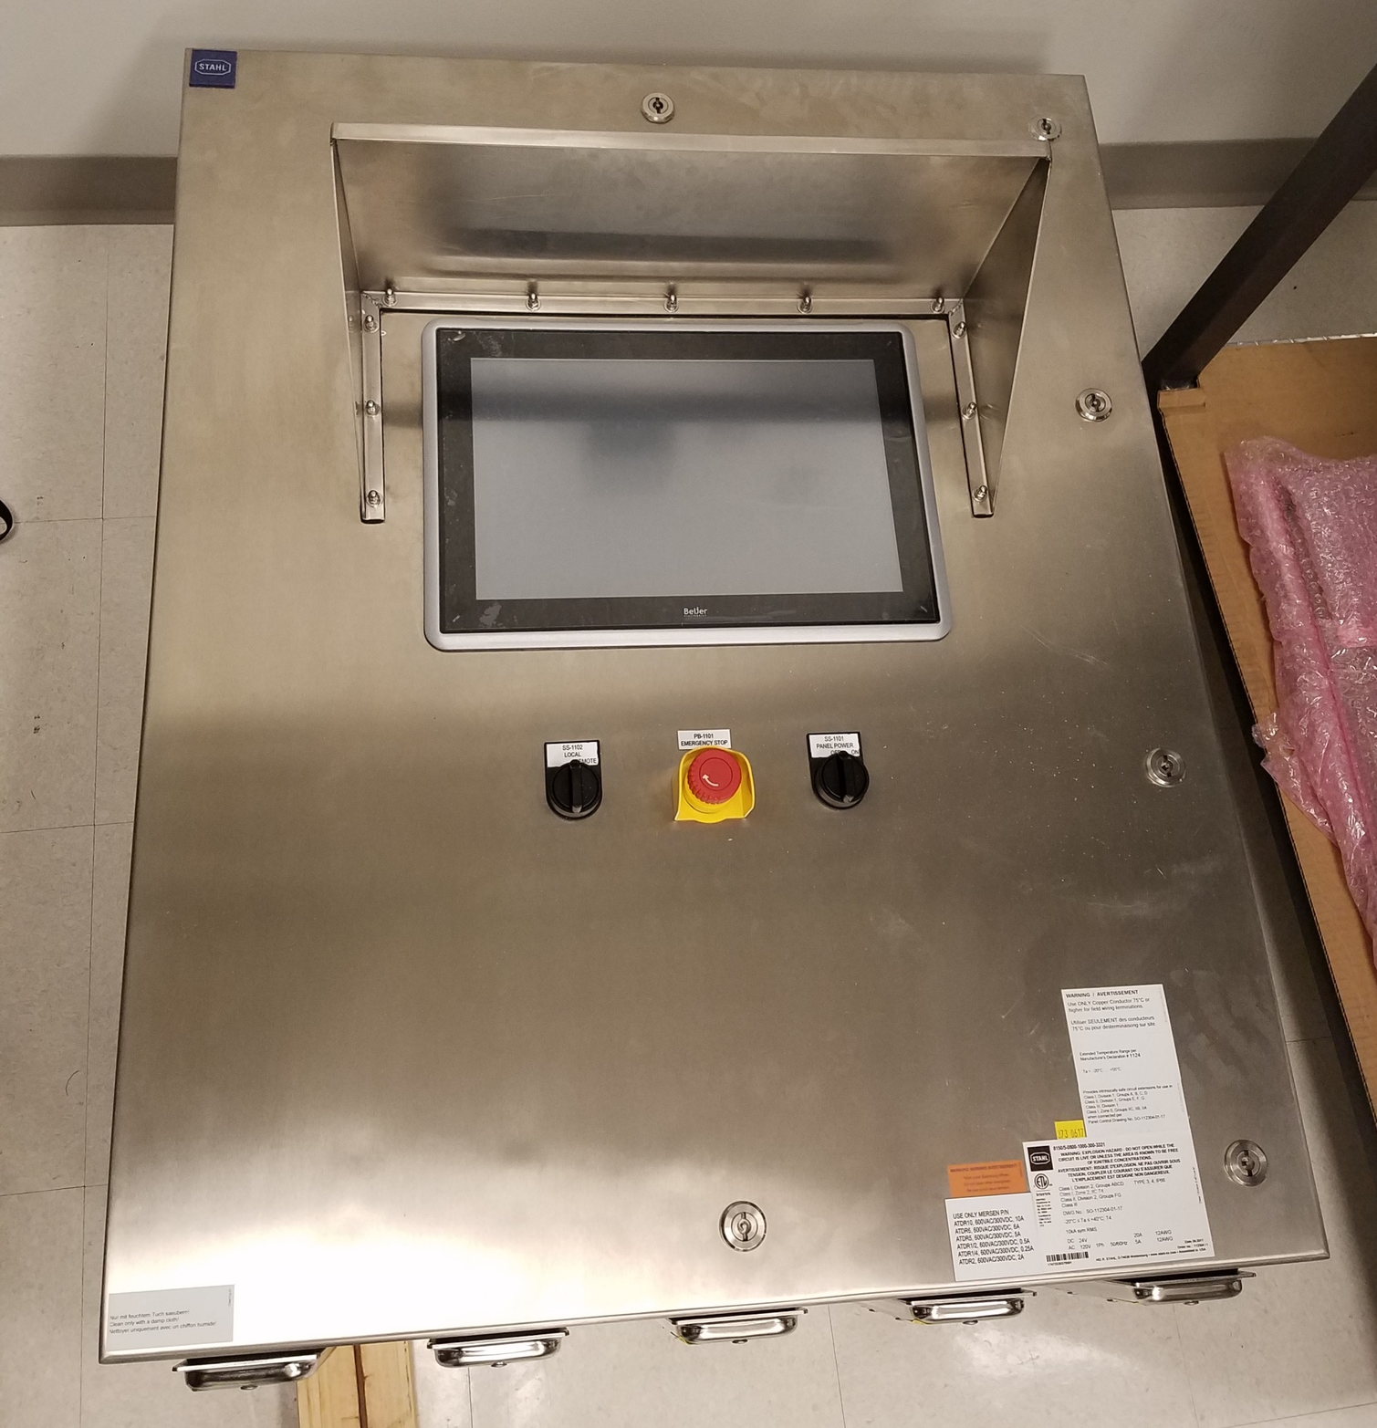
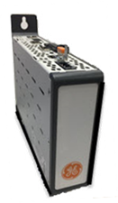
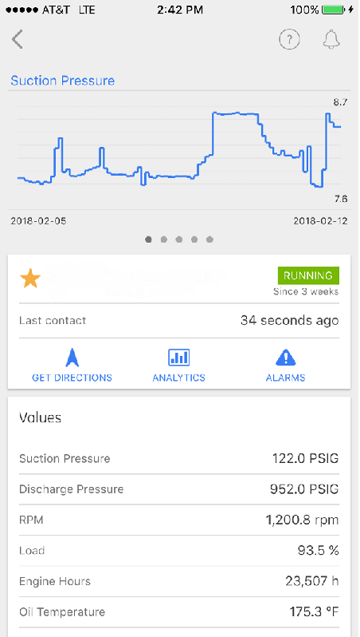
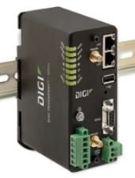
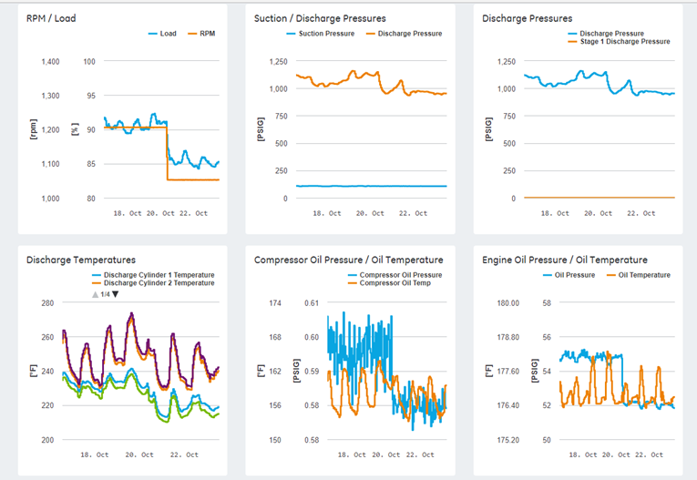
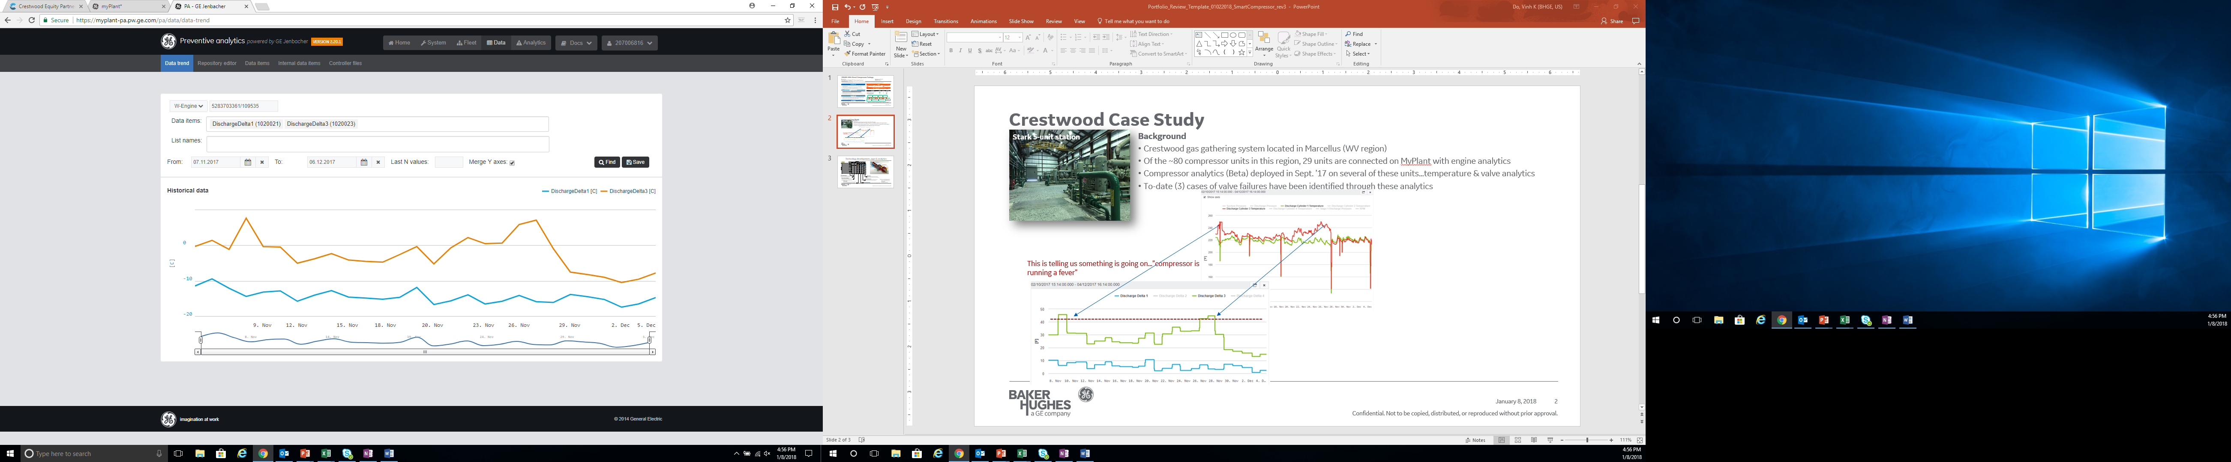
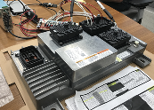
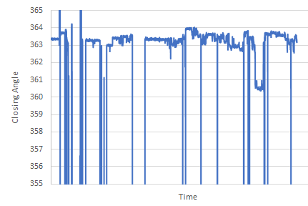
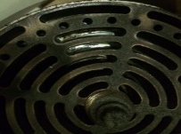
Smart Compressor System
Assets
Connectivity
Insights
Compressor package process Instrumentation
Key Features
Comprehensive health monitoring
Compressor & engine analytics
Internal pressure monitoring & analytics
Compressor digital twin – performance & compressor simulation
Integrated Controller
PLC + Edge
APM Module
Cell Router
+
Benefits
Detect, diagnose & proactively plan
Increased reliability & efficiency
Case study…temp & valve analytics have predicted several valve issues
Detect
Hi speed DAQ
Early detection
Limits
Diagnose
In cylinder pressure
Closing limits
Failed valve
Valuable insights can be derived from typical process data
In cylinder pressure data provide comprehensive compressor health
Integrated controller…Edge & Cloud functionality
In cylinder pressure measurement
Reliable and secure data transmission
Configurable based on needs
Monitoring & analytics through MyPlantTM platform
Providing real time insights for proactive planning
Ongoing developments…Edge analytics & optimization

Slide 9
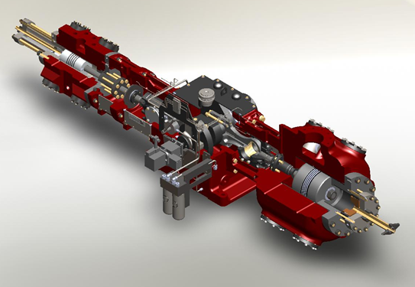
Technology development
Valve Performance
Maintenance
HP/Flow Opt
Frame Vibe
Rod Loads & Reversals
Valve & Ring Leakages
Maintenance
Analytics (pulsation)
RPM
Flow & HP
Lube Oil Temp & Pressure
Oil Level
Discharge Temp
Analytics (valves)
General Dashboard
Real time asset condition visibility of key comp parameters including shutdowns/alarms
PV Analytics
Provide near real time assessment of overall compressor health including valve & ring leakages
Physics-Based Analytics
Provide early indication of potential issues
Discharge Temperature…potential valve issues
Stage Pressures…potential pulsation issues
Valve Performance
Real time assessment of valve performance & early indication/prevention of potential valve issues
Future development…
+Bearing Performance
+Vibration
+Oil Performance
Op Envelope
Real time assessment of comp performance allowing for safe operation through range of op conditions
  Flow/HP
  Rod & Crankpin Loads
  Reversals
HP/Flow Optimization
Maximize throughput w/advisory on capacity controls for safe operation

Slide 10
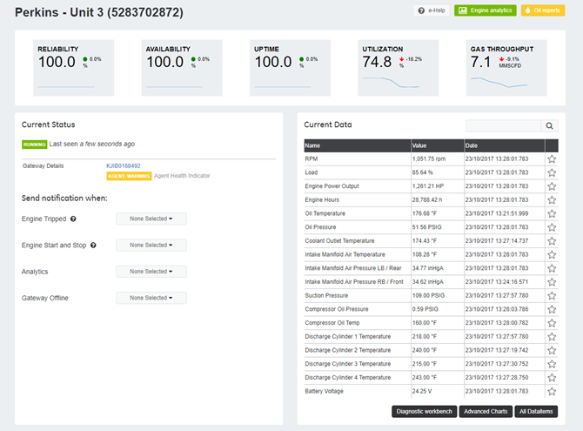
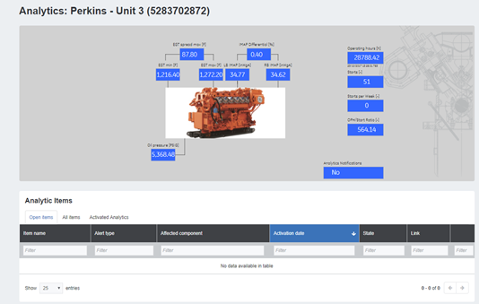
myPlant Dashboard Features
Main Page
Analytics Page
Completed 1Q18!
IMAP Differential (%)
EGT spread max (F)
Operating hours (h)
Running Gear
Valves & Rings
xx
xx
xxxx
Cylinders
LB IMAP
RB IMAP
EGT min
EGT max
Starts
OK
OK
OK
xx
xx
xx
xx
xxxx
Starts per Week
xxxx
OPH/Start Ratio
xxxx
Oil Pressure (psig)
Analytics Notifications
xx
xxxx

Slide 11
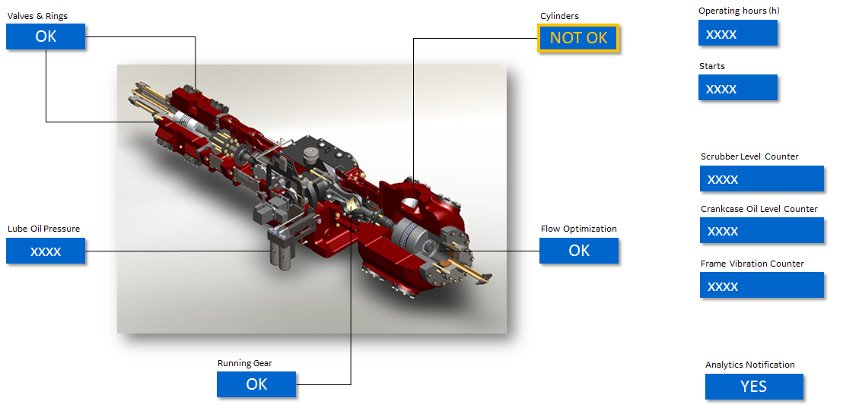
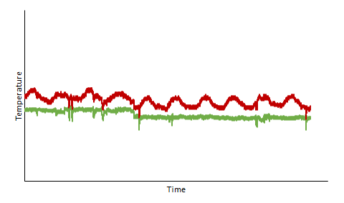
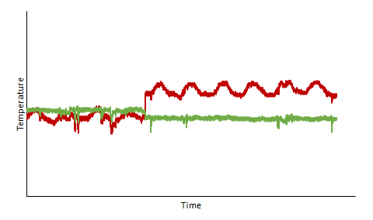
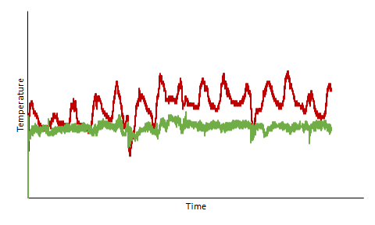
Cylinder Analytics – Discharge Temp Monitoring
This algorithm detects deviation in the cylinder discharge temperatures based on the theoretical discharge temperatures. The approach is to monitor the discharge temperatures and detect slow deviations/drifts from the theoretical temperatures. At detection the algorithm will create an alarm.
Data to be investigated
  Cylinder suction & discharge temperatures
  Cylinder suction & discharge pressures
  Engine speed
Events and analysis of trend data
  Cylinder discharge temperature is a function of stage pressure ratios, speed and suction temperatures. Increasing temperatures can be related to other issues associated with valves, piston rings and packing rings. The algorithm will monitor the actual temperatures against theoretical and will detect increasing deviations/drifts.
Indication in the Analytics Overview
    In case of an issue with the component, it will be directly indicated in the analytics overview either with a warning (yellow) or an alarm (red)
Analytics Overview
Trending Examples
Actual
Baseline
Actual
Baseline
Actual
Baseline
Normal: Deviation in temperature relative to baseline small & consistent over time.
Priority/Action: No action, no ticket
Warning: An abrupt change could be related to issues with leaking valve/rings, data quality or temporary sensor issues
Priority/Action: Check service history. Further monitoring recommended. Inspection on next PM interval
Alarm: A clear gradual increasing drift compared to baseline.
Priority/Action: Check valve and piston rings for abnormal wear.

Slide 12
Case Studies

Slide 13
Temperature Analytics – Unit C2000
Key takeaways/observations
Data taken from Sept. 22nd to Oct. 10th
Units loss communications after Oct. 10th
1st stage #3 cylinder only cylinder to show consistently higher deltas (~9-10 F)
Anomaly observed between 1st stage cylinders
Temperature Signature
Temperature Analytic
Delta 9F
Delta 0F

Slide 14
Temperature Analytics – Unit C2100
Key takeaways/observations
Data taken from Sept. 22nd to Oct. 10th
Units loss communications after Oct. 10th
All cylinders running normally until Oct. 5th and noticed a slight anomaly between 1st stage cylinders
Cylinder #1 showing slow trending in delta (~5F)
Temperature Signature
Delta 9F
Temperature Analytic
Delta 0F

Slide 15
Temperature Analytics – Unit C2200
Key takeaways/observations
Data taken from Sept. 22nd to Oct. 10th
Units loss communications after Oct. 10th
All cylinders running normally until Oct. 1st and noticed beginning anomaly between 1st stage cylinders
Cylinder #1 delta trending towards ~9F
Delta 9F
Delta 0F

Slide 16
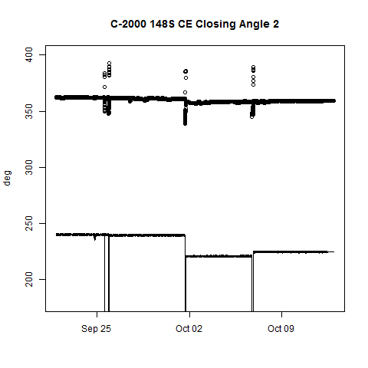
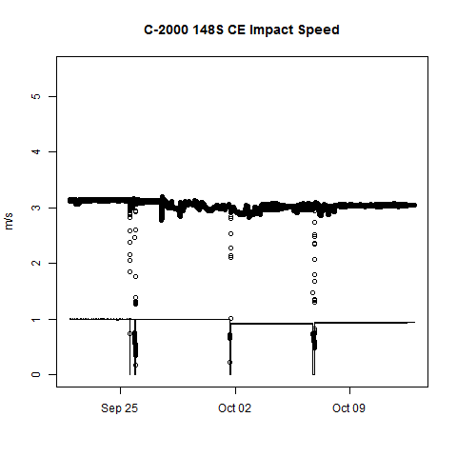
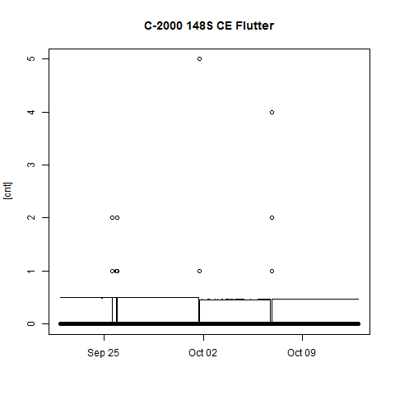
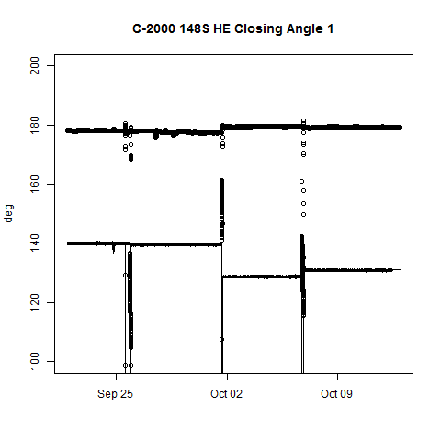
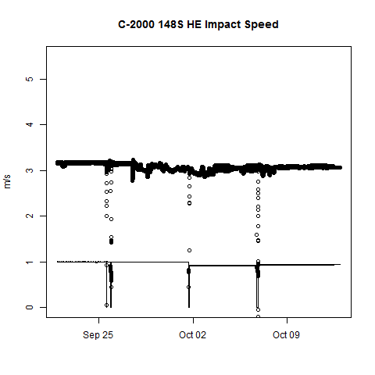
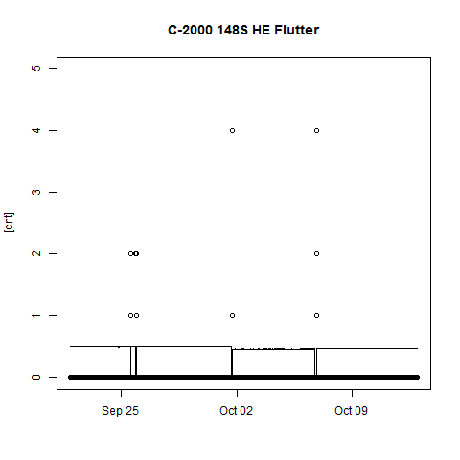
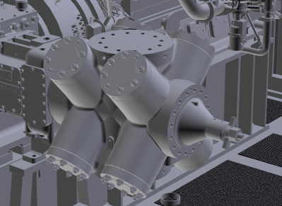
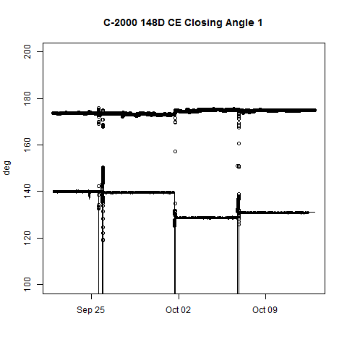
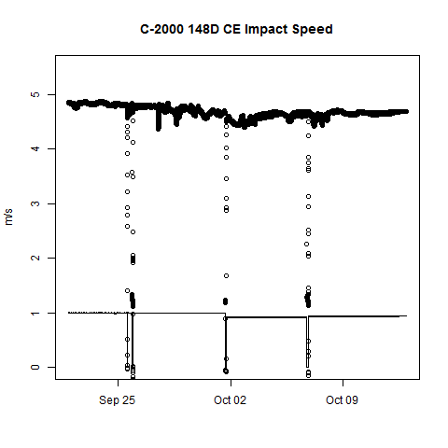
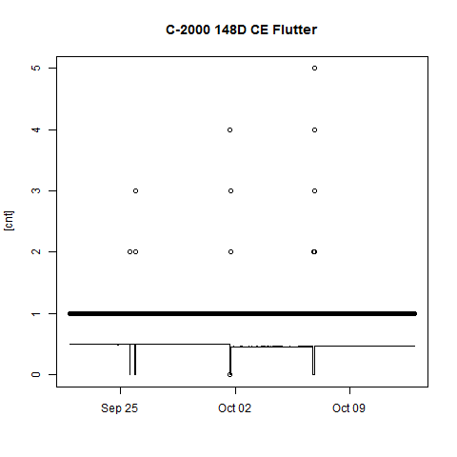
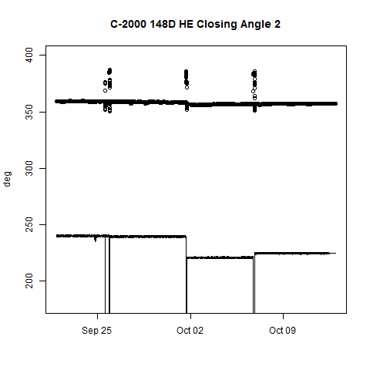
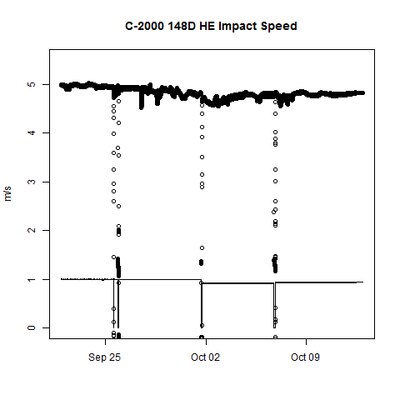
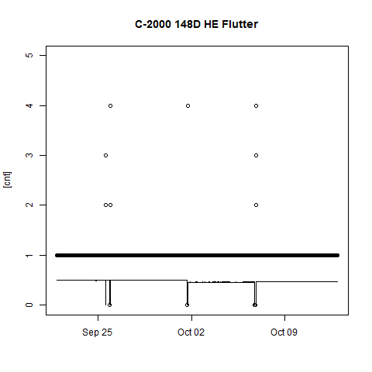
Valve Performance App – Unit C2000 1st Stage Cylinders
CE Suction
HE Suction
CE Discharge
HE Discharge

Slide 17
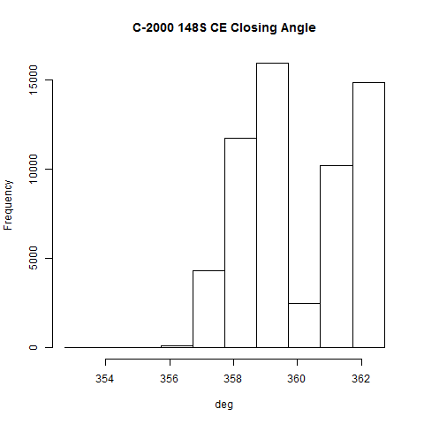
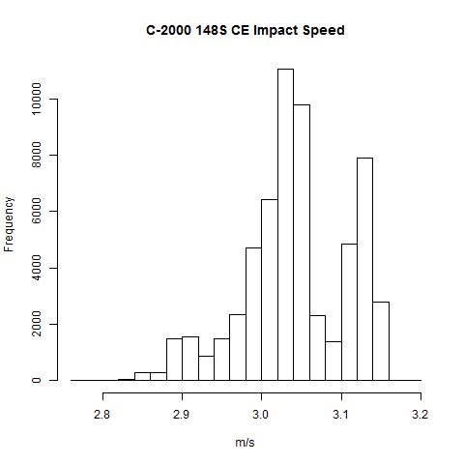
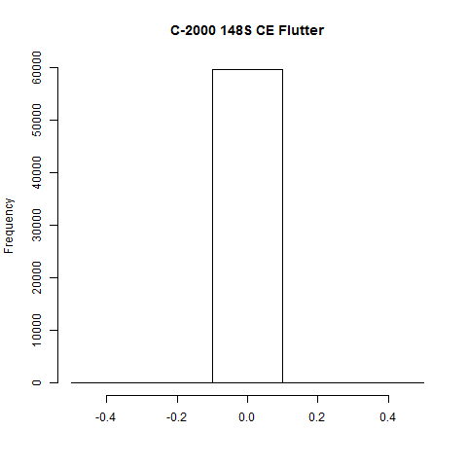
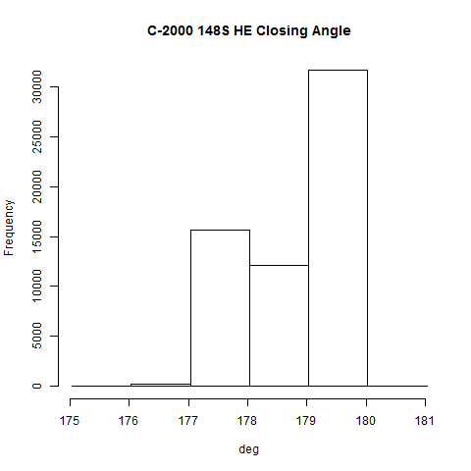
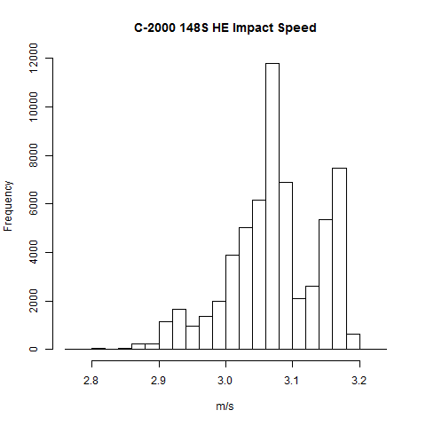

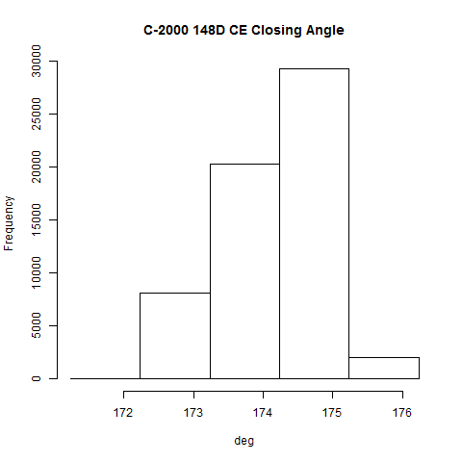
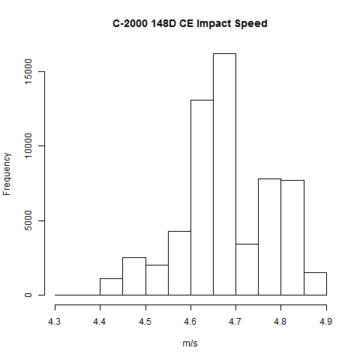
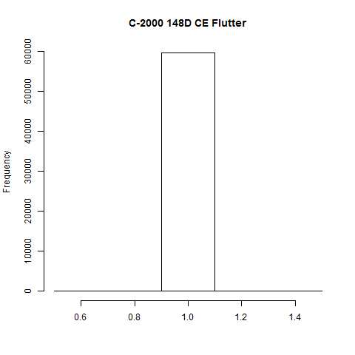
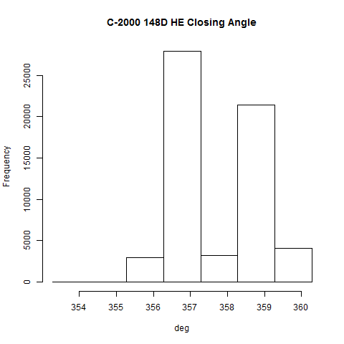
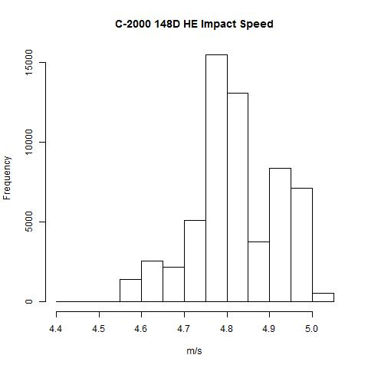

Valve Performance App – Unit C2000 1st Stage Cylinders
CE Suction
Late closing observed for ~40% of operating time
HE Suction
CE Discharge
Impact speed observed higher than C2100
HE Discharge
Late closing observed for ~5% of operating time

Slide 18
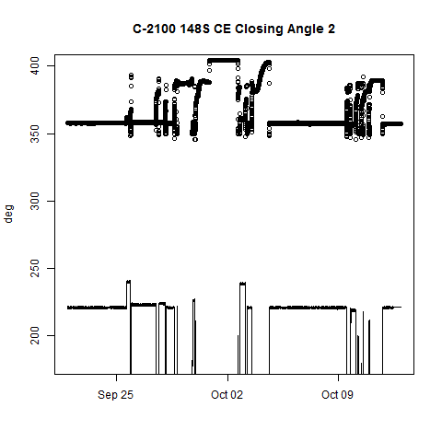
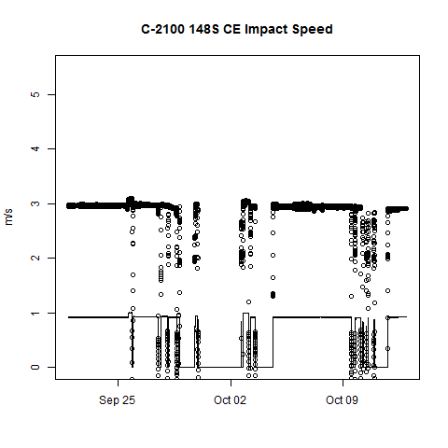
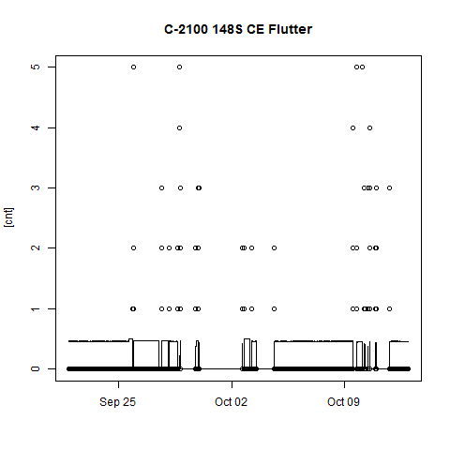
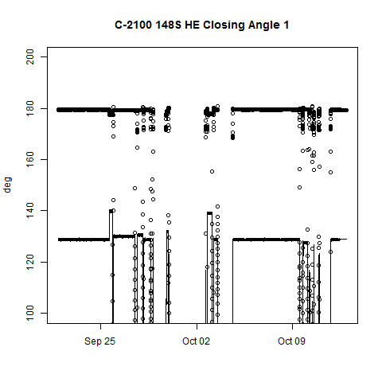
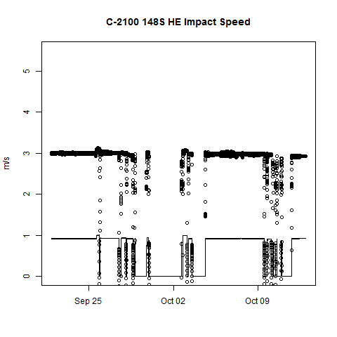
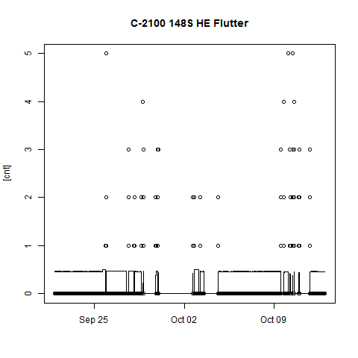
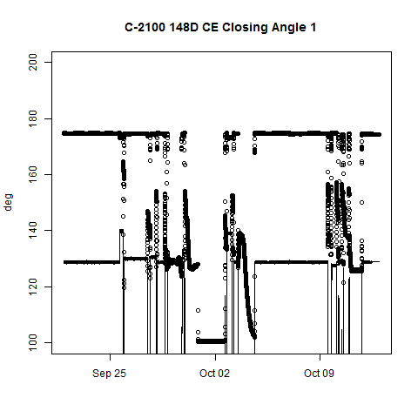
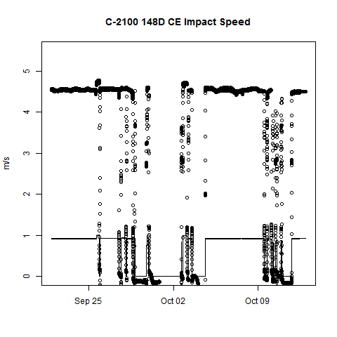




Valve Performance App – Unit C2100 1st Stage Cylinders
CE Suction
HE Suction
CE Discharge
HE Discharge

Slide 19












Valve Performance App – Unit C2100 1st Stage Cylinders
Late closing observed for ~10% of operating time
CE Suction
HE Suction
CE Discharge
HE Discharge

Slide 20












Valve Performance App – Unit C2200 1st Stage Cylinders
CE Suction
HE Suction
CE Discharge
HE Discharge

Slide 21












Valve Performance App – Unit C2200 1st Stage Cylinders
Late closing observed for ~30% of operating time
CE Suction
HE Suction
CE Discharge
Impact speed observed higher than C2100
HE Discharge

Slide 22
Summary of Observations from Temp & Valve Analytics
Unit | Temp Analytic | Valve App
C2000 | 1st Stage Cyl #3 deltas running ~10F consistently 1st Stage anomaly observed 100% of time | Late closing observed on CE suction for ~40% of time Late closing observed on HE discharge for ~5% of time
C2100 | 1st Stage Cyl #1 deltas running ~5F 1st Stage anomaly trending ~30% of time | Late closing observed on CE suction for ~10% of time
C2200 | 1st Stage Cyl #1 deltas trending~9F 1st Stage anomaly trending ~50% of time | Late closing observed on CE suction for ~30% of time

Slide 23

Unit 2300
Case Study
1st stage – 2x 12” DA cylinders (cylinder 1 & 3)
2nd stage – 2x 6.25” DA cylinders (cylinders 2&4)
2 stage 4-throw compressor
Discharge Temperature - Cylinder #1
Discharge Temperature - Cylinder #3
Discharge temperature monitoring showed sudden change in 1st stage cylinder #3 compared to corresponding cylinder #1 (see Figure 1).

Slide 24


Unit 2300
Case Study
2 stage 4-throw compressor
Delta Discharge Temperature - Cylinder #1
Delta Discharge Temperature - Cylinder #3
Customer was notified
trends started diverging
Trend running below alarm/warning limits after valve reinstallation
1st alarm - warning alarm for divergence
2nd alarm - “red” alarm reached – customer shut down and performed recommended maintenance
Confirmed bad valve & back to normal operating conditions afterward
Image of damaged valve
Notes:
On Oct 12th the customer was notified that cyl #1 and cyl #3 discharge temperature trends started diverging from each other. As soon as cyl #3 deviation achieved alarm limit, notification was sent to machine operator. In the following days, customer decided to shut down unit and performed unit inspection. It was found that cylinder #3 Crank End (CE) suction & discharge valves were damaged causing losses on machine performance and creating potential risk of damage to other running gear components. After new CE valves were installed, operator noticed cylinder #1 and cylinder #3 trends to converge again and running below alarm/warning limits.

Slide 25
Summary of Valve Failure Costs
Unit | Hours of Data | Stage 1 Failed Valve Hours | Stage 2 Failed Valve Hours | Revenue Lost [$] | Notes
C2000 | 5688 | 355 | 0 | $11,921.40
C2100 | 7944 | 256 | 0 | $3,681.60 | Average failure lasted 3-4 days before detected/fixed
C2200 | 5496 | 16 | 0 | $152.00 | Only 1 failure for 16 hrs
C2300 | 5544 | 648 | 143 | $11,400.00 | Stage 1 had multiple failures from 6/7 to 6/13 and 10/20 to 11/10, Stage 2 failure 01/13/18 to 01/19/2018
C2400 | 1662 | 0 | 0 | $ - | Not enough data
Unit 3 | 8976 | 4109 | 736 | $70,156.40 | Frequent overload, undetected valve failure from 5/10/17 to 10/24/17
Unit 4 | 10800 | 214 | 106 | $7,900.00 | Also failure from 7/8/16 to 2/22/17 costing $77,000 but ignored because could be other sensor/component failure
Unit 2, Unit 3, Unit 4, Unit 5 | 7032, 7728, 6120, 4320 | 0 | 0 | $- | Unit 4 one failure on 4/21 fixed in 18hr. No valve failures on other units
C-203, C-204, C-205, C-206, C-207 | 24, 1272, 168, 840, 888 | 0 | 0 | $- | Limited data (1-2 months)
C100 | 2784 | 1600 | 2328 | $57,169.60 | Two long failures (>900 hrs) contribute to the high number. Possible ongoing failed valve on stage 2 (failed 01/02/2018)

Slide 26


Slide 27


Slide 28


Slide 29


Slide 30


Slide 31
Building a Digital Asset Management Program

Slide 32
Considerations
What systems and data are being collected currently?
What would bring the most value?
What resources do you have available?
Modular, scalable solutions work best!

