Slide 1
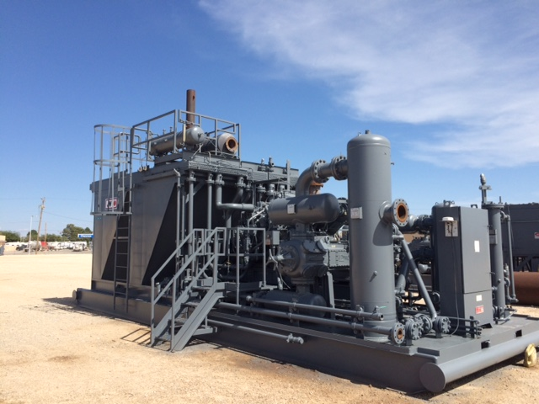
Applying OSHA’S WALKING & WORKING SURFACES STANDARD TO FIELD GAS COMPRESSION
Joe Avila, HSE Supervisor, JWPC

Slide 2
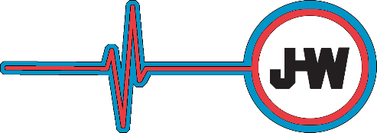
Objectives
New requirements and recent data
Common challenges faced
Evaluations and Inspections
Solutions
Resources

Slide 3
Walking/Working Surfaces
In January 2017, OSHA’s Revised CFR 1910, Subpart D, Walking and Working Surfaces rules took effect.
Purpose is to prevent slips, trips, and falls in general industry workplaces
Covers U.S. Oil and Gas industry
Offices, facilities, field locations and equipment are all affected

Slide 4
Walking/Working Surfaces
WWS safety practices have become part of normal life in an office or shop environment. In the field? Not always
Most on-shore oil/gas production locations have numerous types of equipment, storage tanks and surface piping, contributing to a high level of slip, trip and fall injuries
Organizations such as the BLS, AESC, NSC and insurance companies list slips, trips and falls (same level), and falls (lower level) as leading causes of injury and/or fatality in the U.S. Oil & Gas industry.
Most occur at rural field locations
Field gas compression equipment in particular requires constant service and maintenance, often above surface height

Slide 5
Walking/Working Surfaces
Proper work surfaces are required where employees are performing frequent work, as free of hazards as possible
Non-slip platforms/work surfaces in routine maintenance areas on the package (beside engines, at valves, filter bottles, etc.)
Proper stairways, steps or ladders are required to access any work platform/surface where a “step up” of 19 inches or more is present*
A guard rail system or other acceptable form of fall protection is required for all work platforms where an employee could fall 48 inches or more to the surface below. (on top of coolers, at air intakes, beside engines)
When fixed ladders or stairs are not practical, other acceptable methods must be used* (*not part of Revised Subpart D regs)

Slide 6
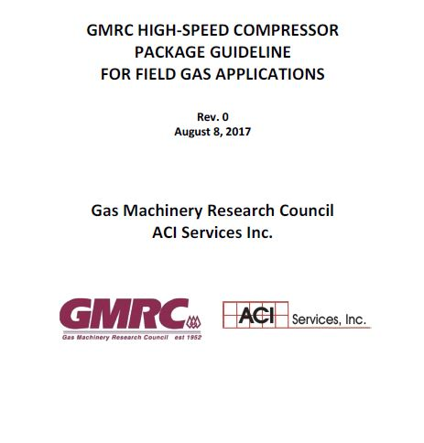
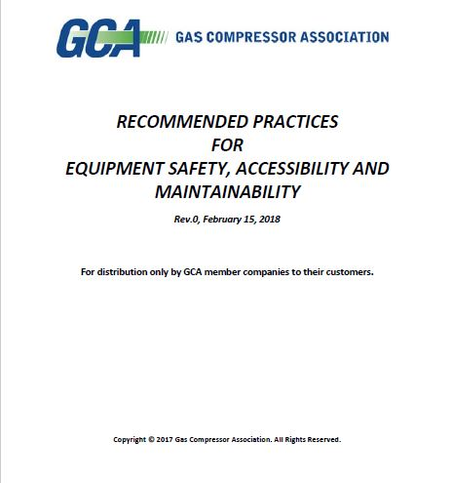
Industry Standard
2017 GMRC Guideline. GCA partnership for:
Section 12 - OSHA WWS for the equipment itself
Section 14 - WWS issues up to/around the compressor

Slide 7
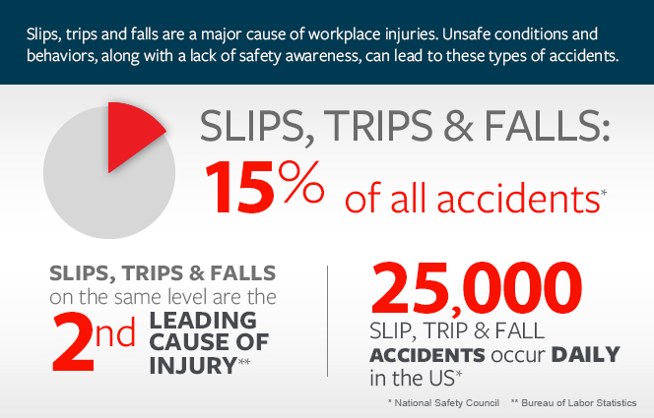
Statistics
Fall Type:
On same level – 137,079
Floors
Walkways
Other surfaces
To lower level – 48,379
Stairs or steps
Docks
Ladders
Roofs
Nonmoving vehicles

Slide 8
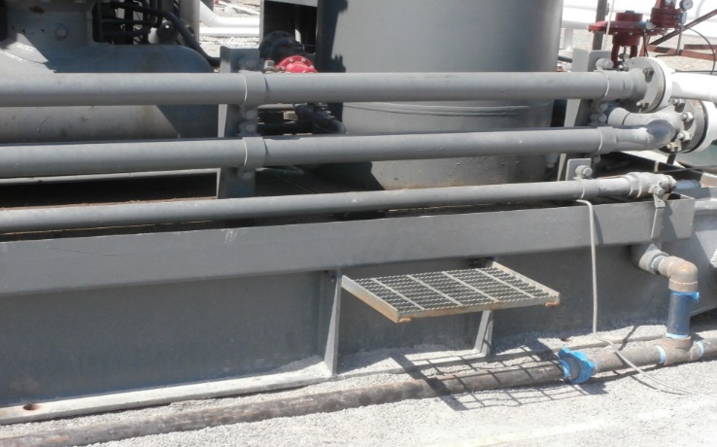
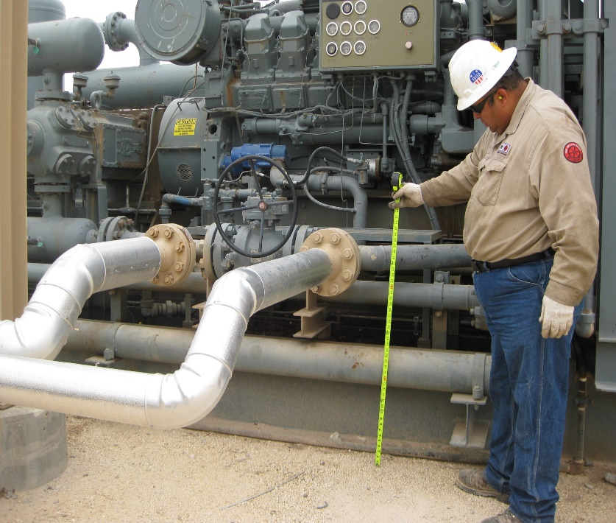
Common Challenges
Safe access to engine service platform, platform dimensions, lack of protective railing
Safe access to elevated components – valves, level kills, surge tanks, exhaust catalyst elements
Special situations
Access to the compressor package
Also:
On-skid piping, conduit/wiring, etc. obstructing access
Oil, antifreeze, chemicals on skid; weather (non-slip tread/surfaces)

Slide 9
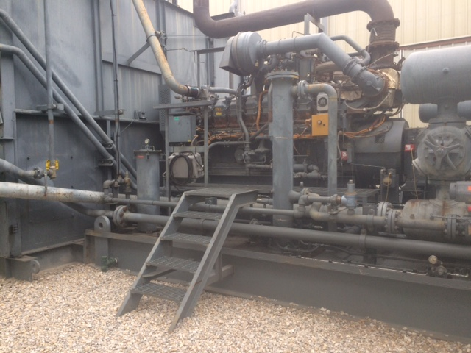
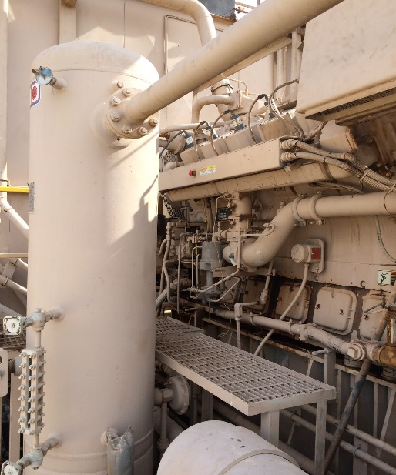
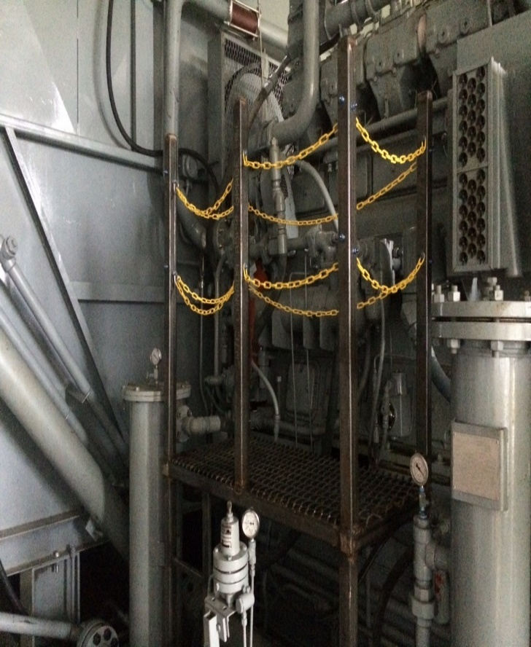
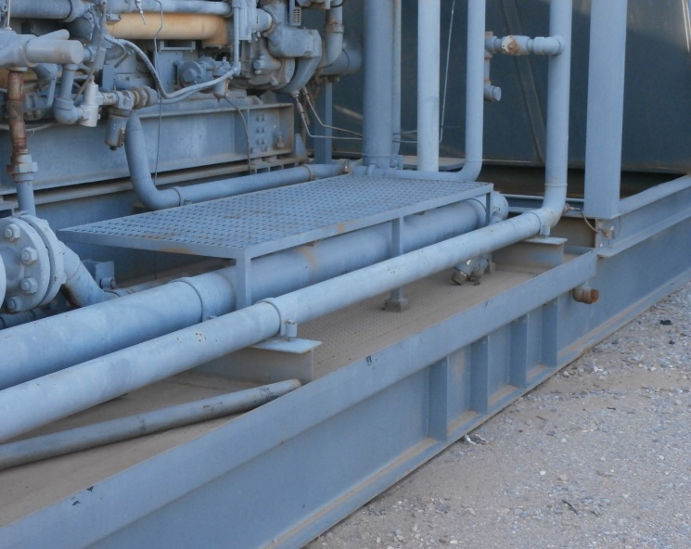
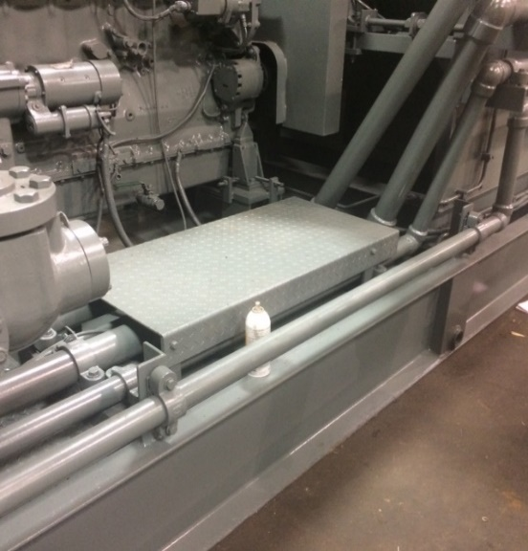
Common Challenges
Engine service platforms

Slide 10
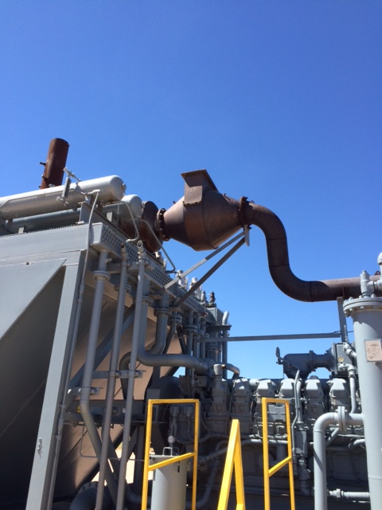
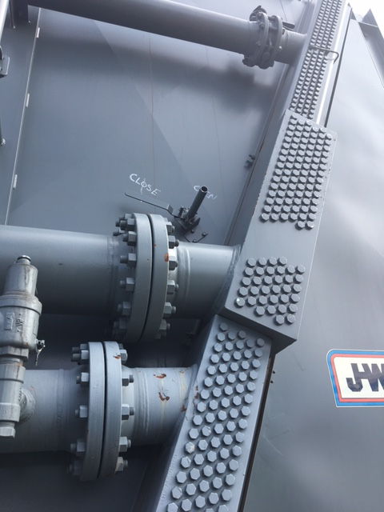
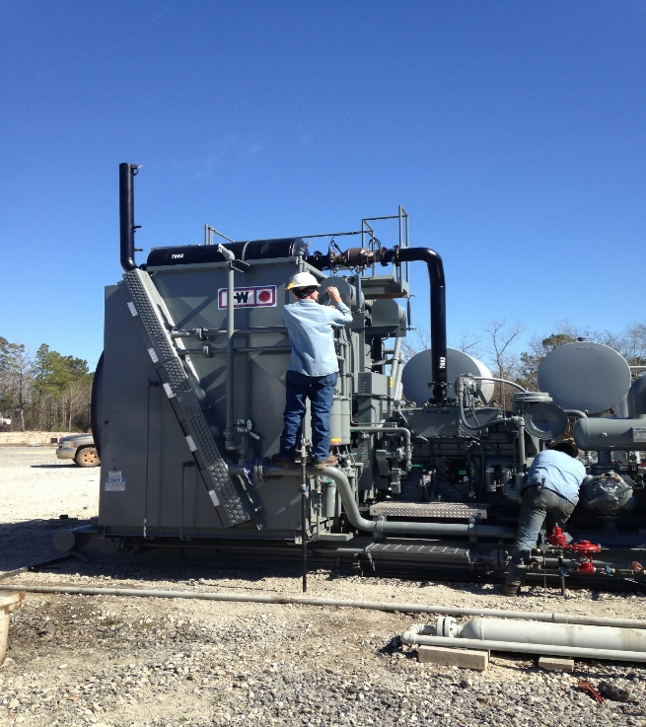
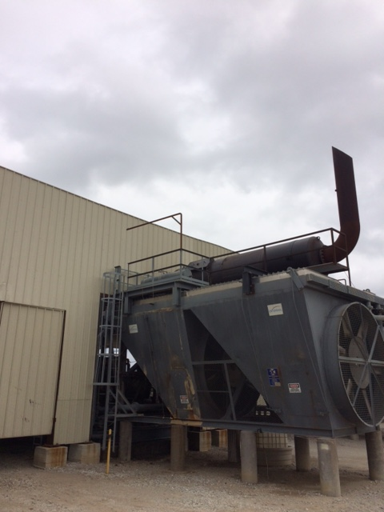
Common Challenges
Elevated components

Slide 11
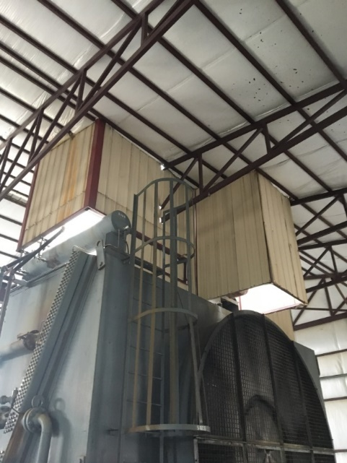
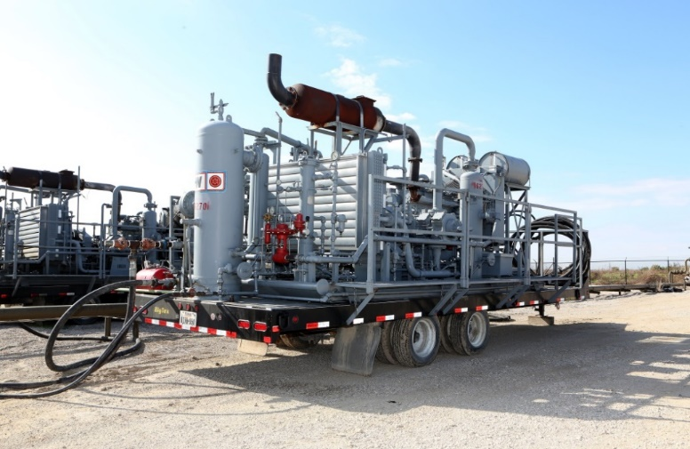
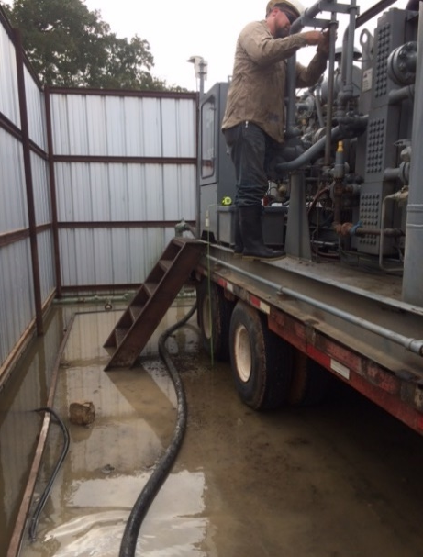
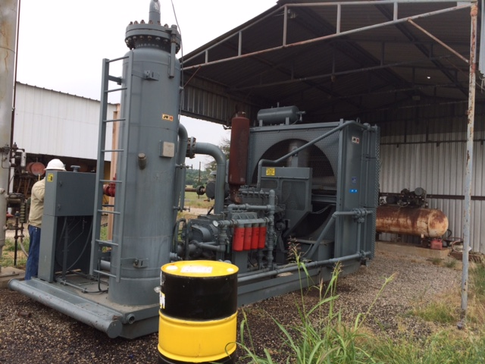
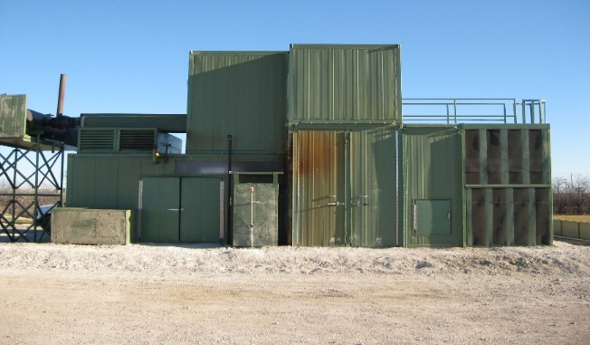
Common Challenges
Special situations – units in buildings or noise containment; trailer-mounts

Slide 12
Why such challenges?
Age of units - built at different times, different standards
Many, many compressor unit packagers
Units bought/sold, acquisitions and mergers
Modifications by field shops/techs
Requirements of End Users, manner set
Engineering/manufacturer requirements, such as catalyst temps
Ladders, other WWS items lost during unit moves
Need to maintain portability – low height/width/weight

Slide 13
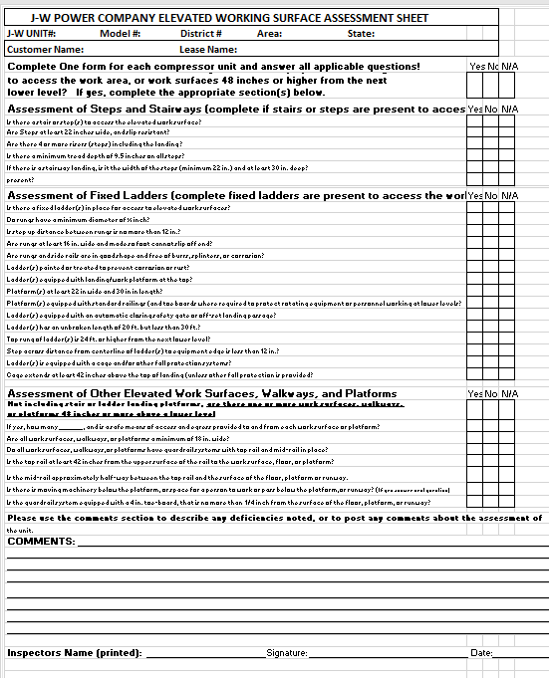
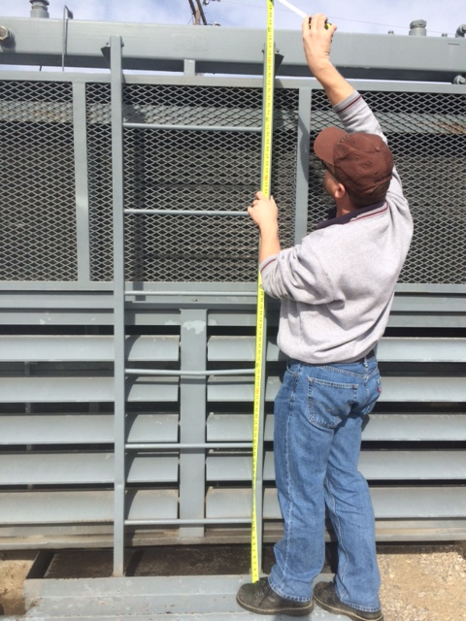
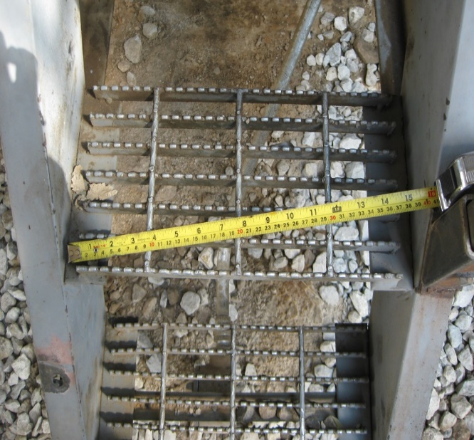
Evaluations and Inspections
Now Required: WWS Inspections
WWS Equipment Assessments and Forms (Not required, but best practice)
Document existing compliance, needed improvements, measurements
Before/after photos

Slide 14
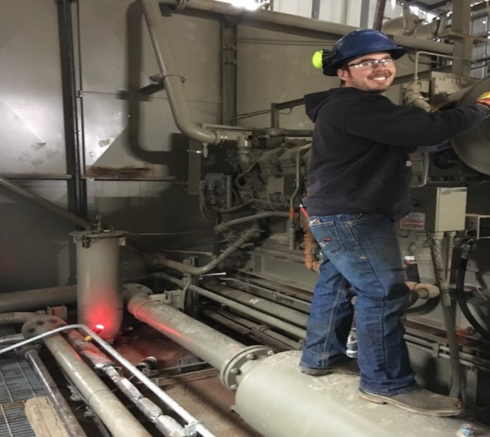
Evaluations and Inspections
Regular Inspections
On a schedule adequate enough to identify hazards
As Needed Inspections
When conditions, circumstances, or events occur that warrant an additional check to ensure that WWS are safe for use
Existing Tools – Field audits by HSE/Supervision, PM/Service Reports, JSAs, BBS Observations
Standing on piping and pressure vessels to perform work tasks is not best practice…

Slide 15
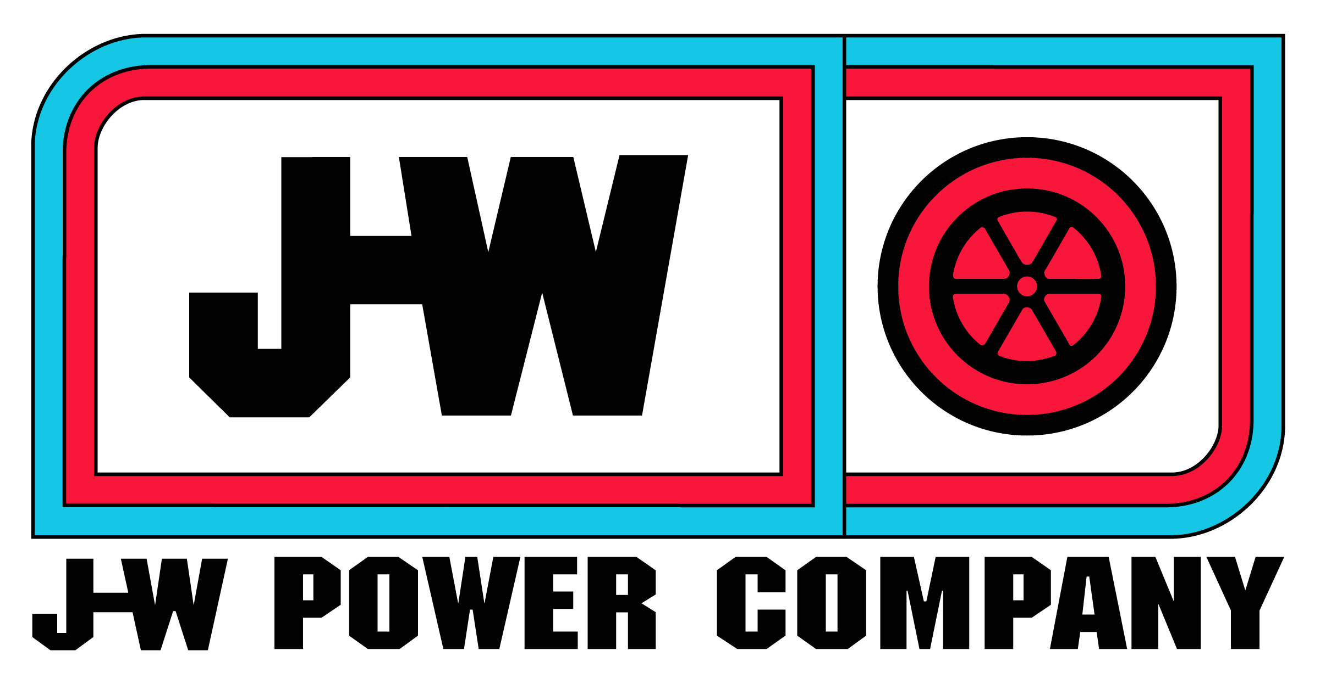
SOLUTIONS

Slide 16
What are our Goals?
Make our equipment safer for our employees and OSHA-compliant.
What is safest may not always be required by OSHA
Analyze tasks, identify hazards, speak with Service Techs
Determine the safest and most cost-effective solutions, and utilize them going forward, across the board.
Use hazard controls hierarchy: Engineering, Administrative, PPE
Balance highest level of safety with responsible use of resources
Upgrades in the shop vs. field

Slide 17
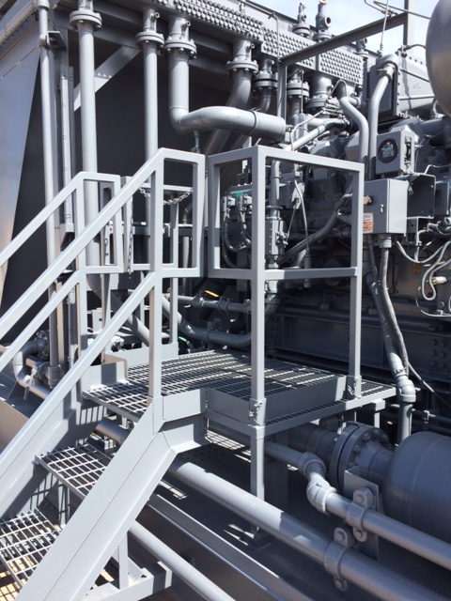
Work Platforms
Must be sturdy, and a non-slip surface (metal grating is best)
At least 22 inches wide, 30 in. depth
If access to the platform requires a step up of 19 in. or more, steps or a stairway are needed
If the platform is 48 in. or more above the ground, guard rails are required
Rails are best practice for exposed edges, even when < 48 in.
Toeboards often not required

Slide 18
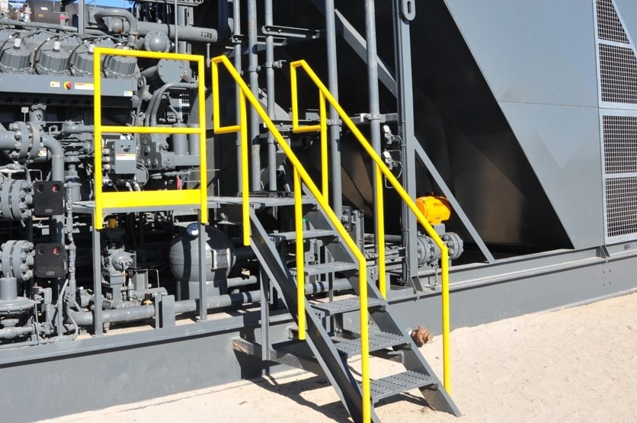
Steps/Stairways
.
Must be sturdy, non-slip surface and at least 22 in. wide
9.5 in. tread depth
4 or more risers need railings
Max height of 9.5in between risers

Slide 19
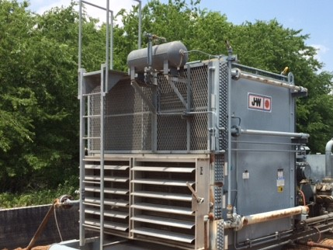
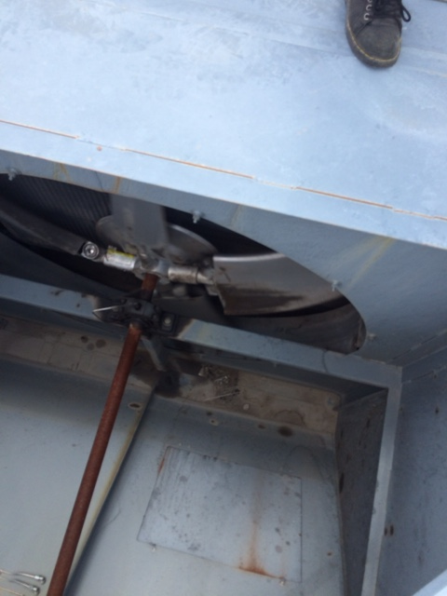
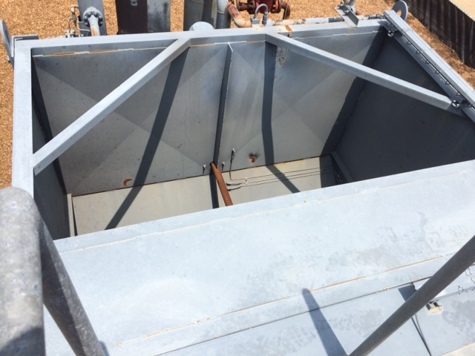
Elevated Components
Engineering – Administrative – PPE
Is there a way to eliminate the need to climb up? (Engineer out the hazard!)
Coolant tanks, level safety kills and exhaust catalysts are three primary concerns. How can engineering/ design changes address these?
Selfie stick!

Slide 20
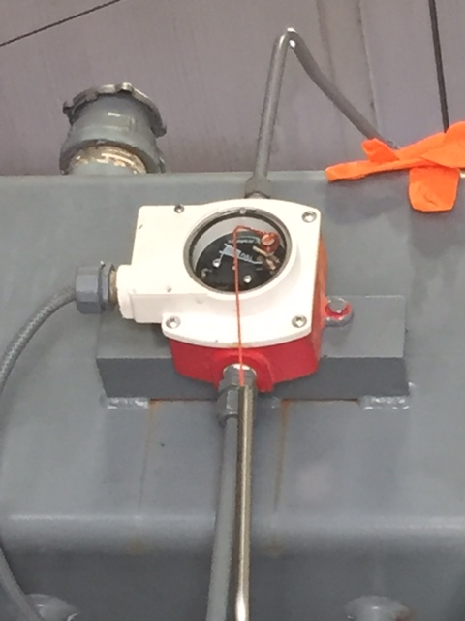
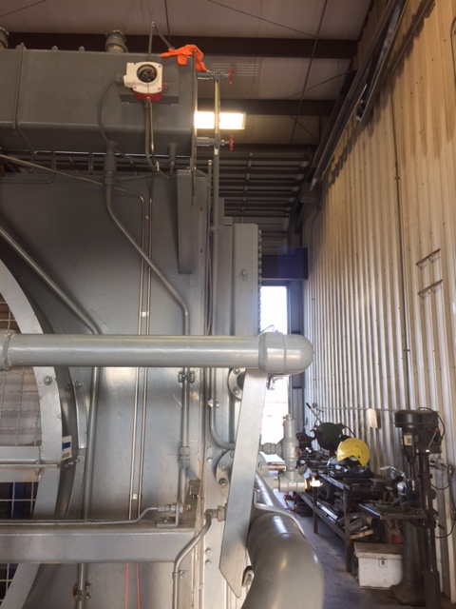
Engineering Controls To Allow Access From Ground/Skid
Coolant level kill switch tested by nylon string

Slide 21
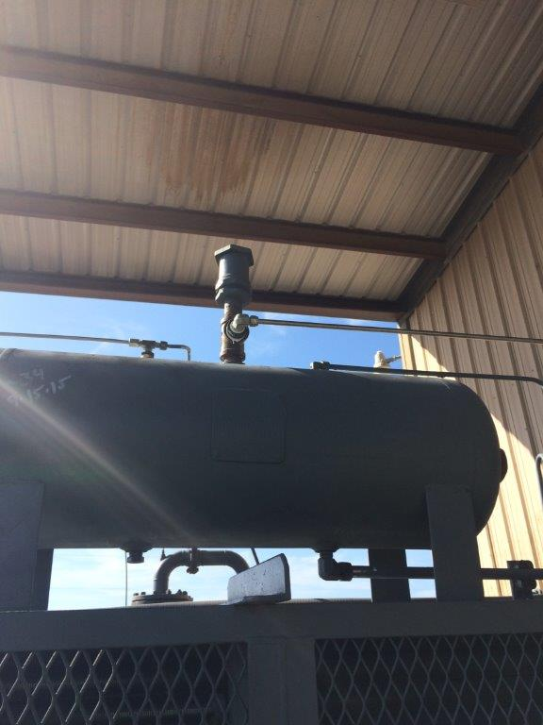
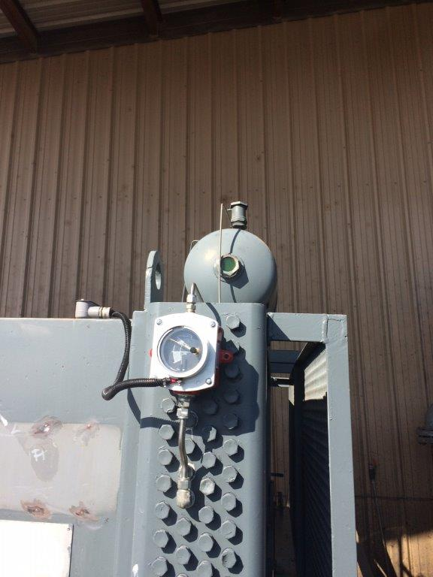
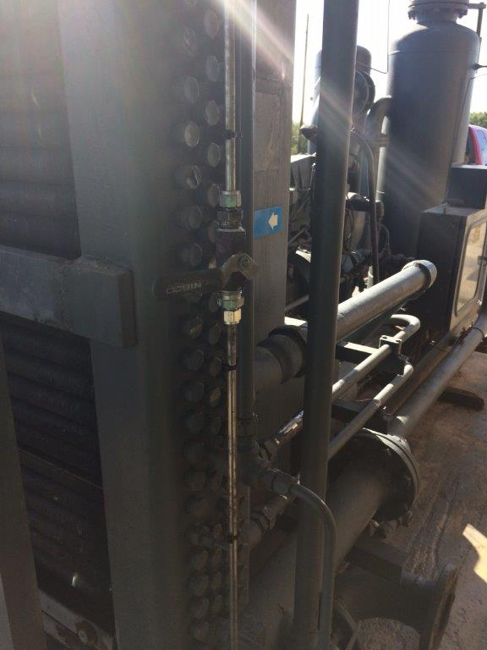
Engineering Controls To Allow Access From Ground/Skid
L-150 level kill within reach from the ground
Coolant tank vented via tubing line and ball valve

Slide 22
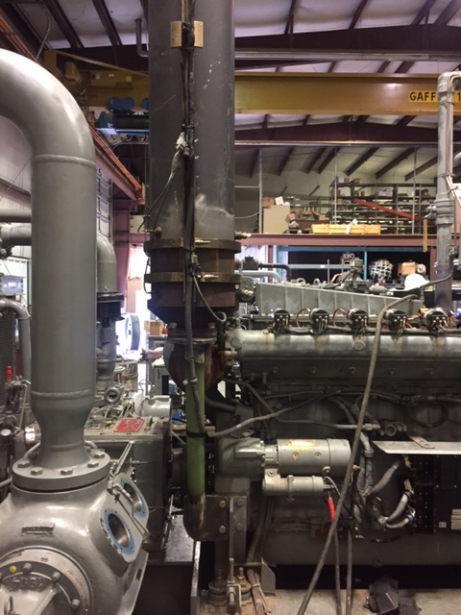
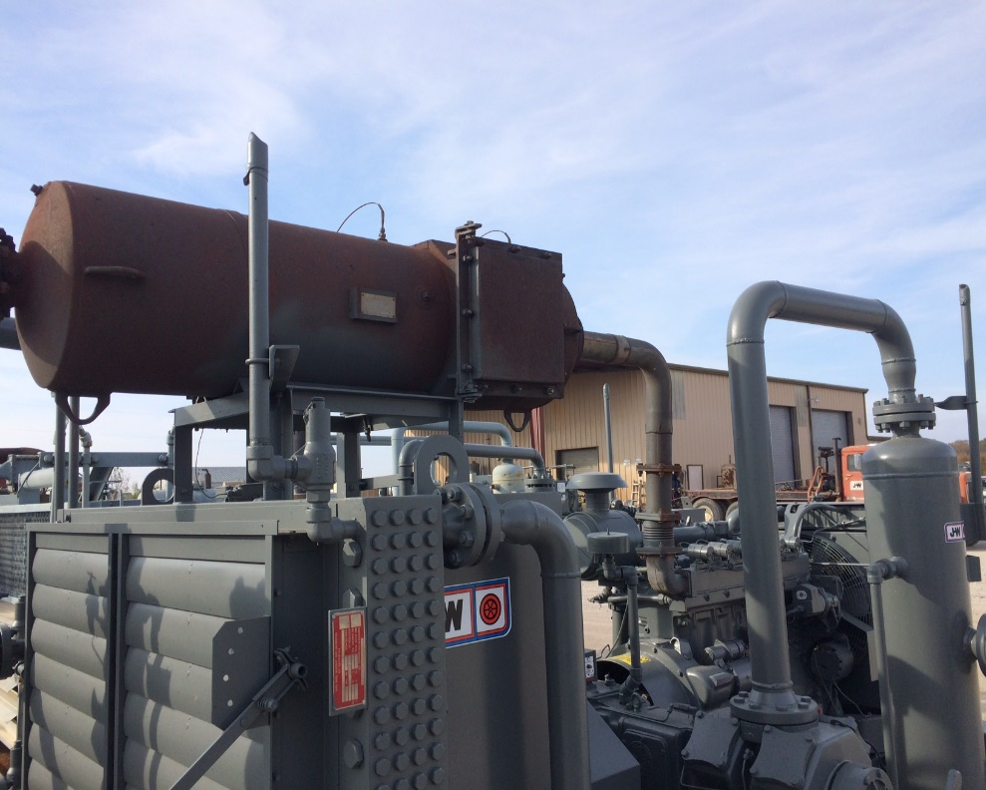
Engineering Controls To Allow Access From Ground/Skid
Replaced with different style
Catalyst rotated 90 degrees, or…

Slide 23
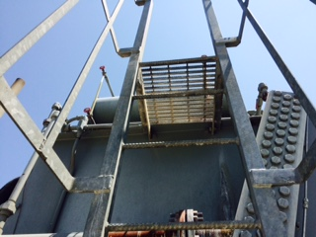
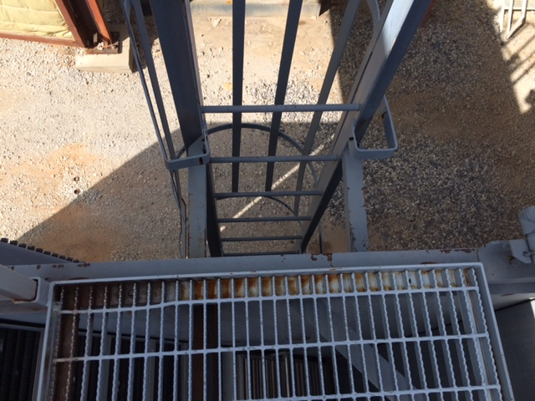
Ladders and Railing
Rungs min. diameter 3/4 in.
Distance between rungs no more than 12 in.
At least 16 in. wide, foot not able to slip off end
Painted or treated for corrosion
Equipped with a landing or work platform at top
Platforms 22 in. x 30 in. minimum (landings can be smaller)
Equipped with self-closing gate or offset landing
Ladder to platform distance less than 12 in.
.

Slide 24
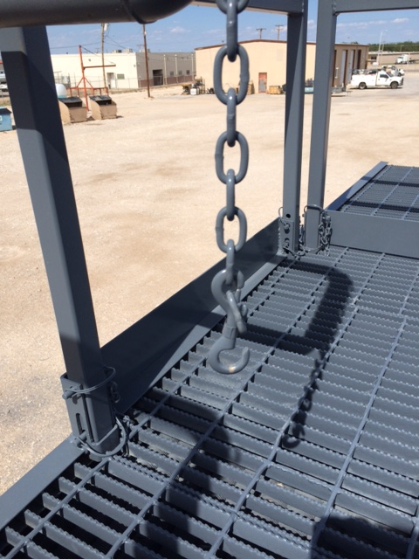
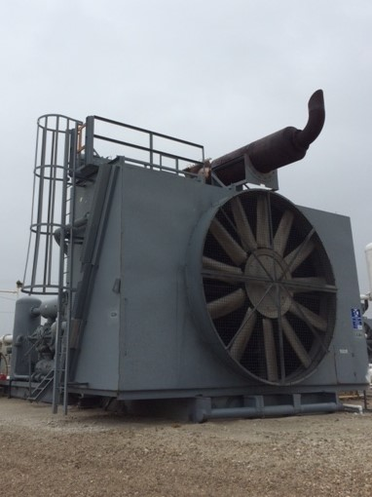
Ladders and Railing
Top rail must be 42 in. high
Mid rail 21 in. high
4 in. toe board required if potential for employees below, or rotating equipment (i.e., cooler fans)
Sturdy construction – withstand 200 lbs. force outward force, anywhere along top rail
No gaps a person could fall through
.
Notice retaining pins for removal or fold-down of rails/ toeboards

Slide 25
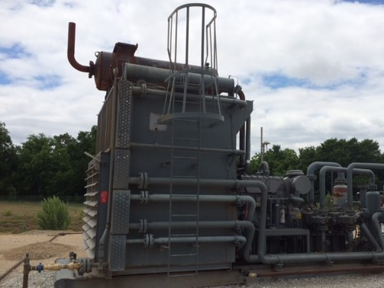
Ladder Fall Protection
Fixed ladders reaching 24 ft. or higher required to have cage or other fall protection*.
Many shorter ladders already have cages. It is fine to leave them.
All fixed ladder cages or rails must extend at least 42 in. above work surface
.

Slide 26
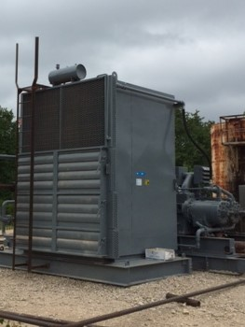
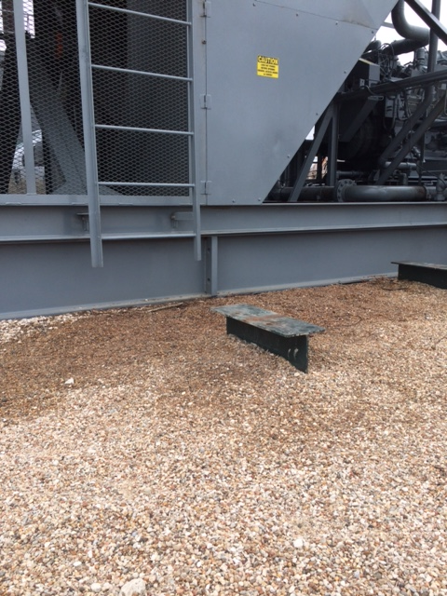
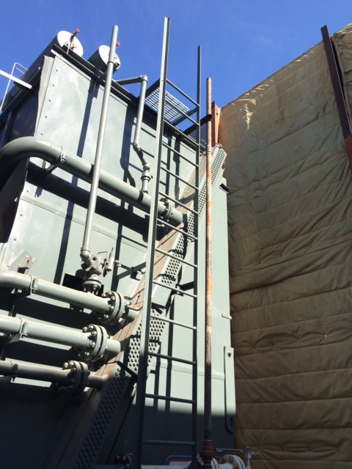
Ladder Fall Protection
During inspections, ensure fixed ladders are as safe for the user as possible:
Ladder rails easy to grasp and use; ladder rungs non-slip surface; NO objects blocking access below or up top.

Slide 27
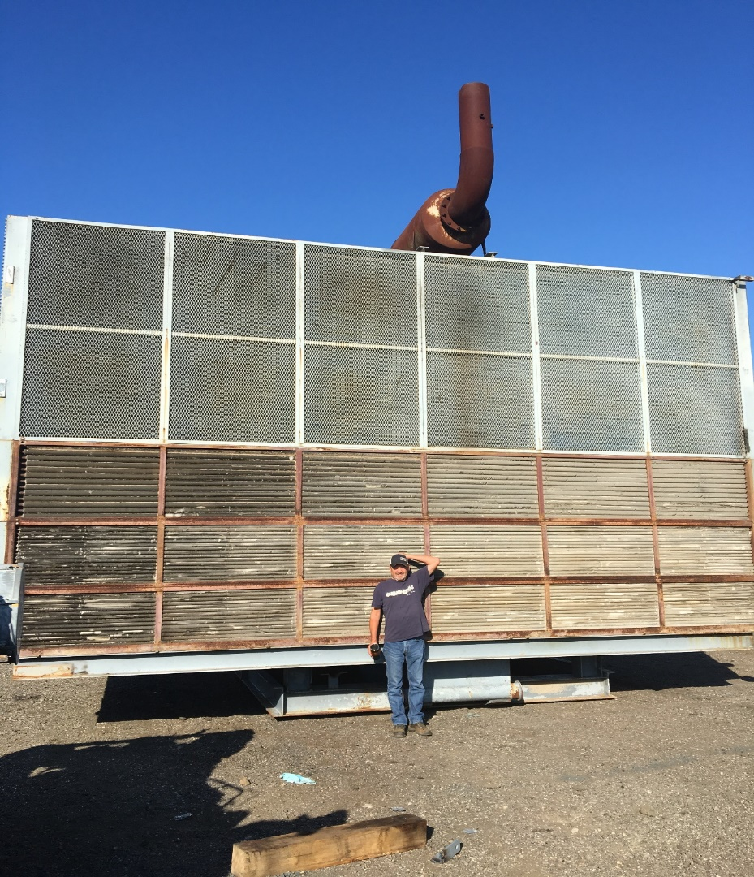
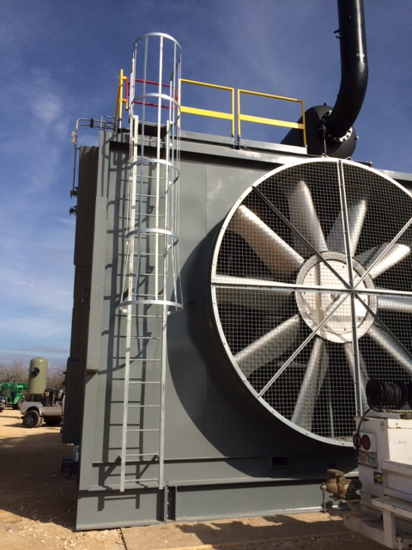
Ladder Fall Protection
*OSHA has a series of dates phasing out ladder cages as the sole method of fall protection*.
For gas compression, affects mainly large horsepower (24 ft. or higher.)
Personal fall arrest or ladder safety systems must be used after 11/19/2018

Slide 28
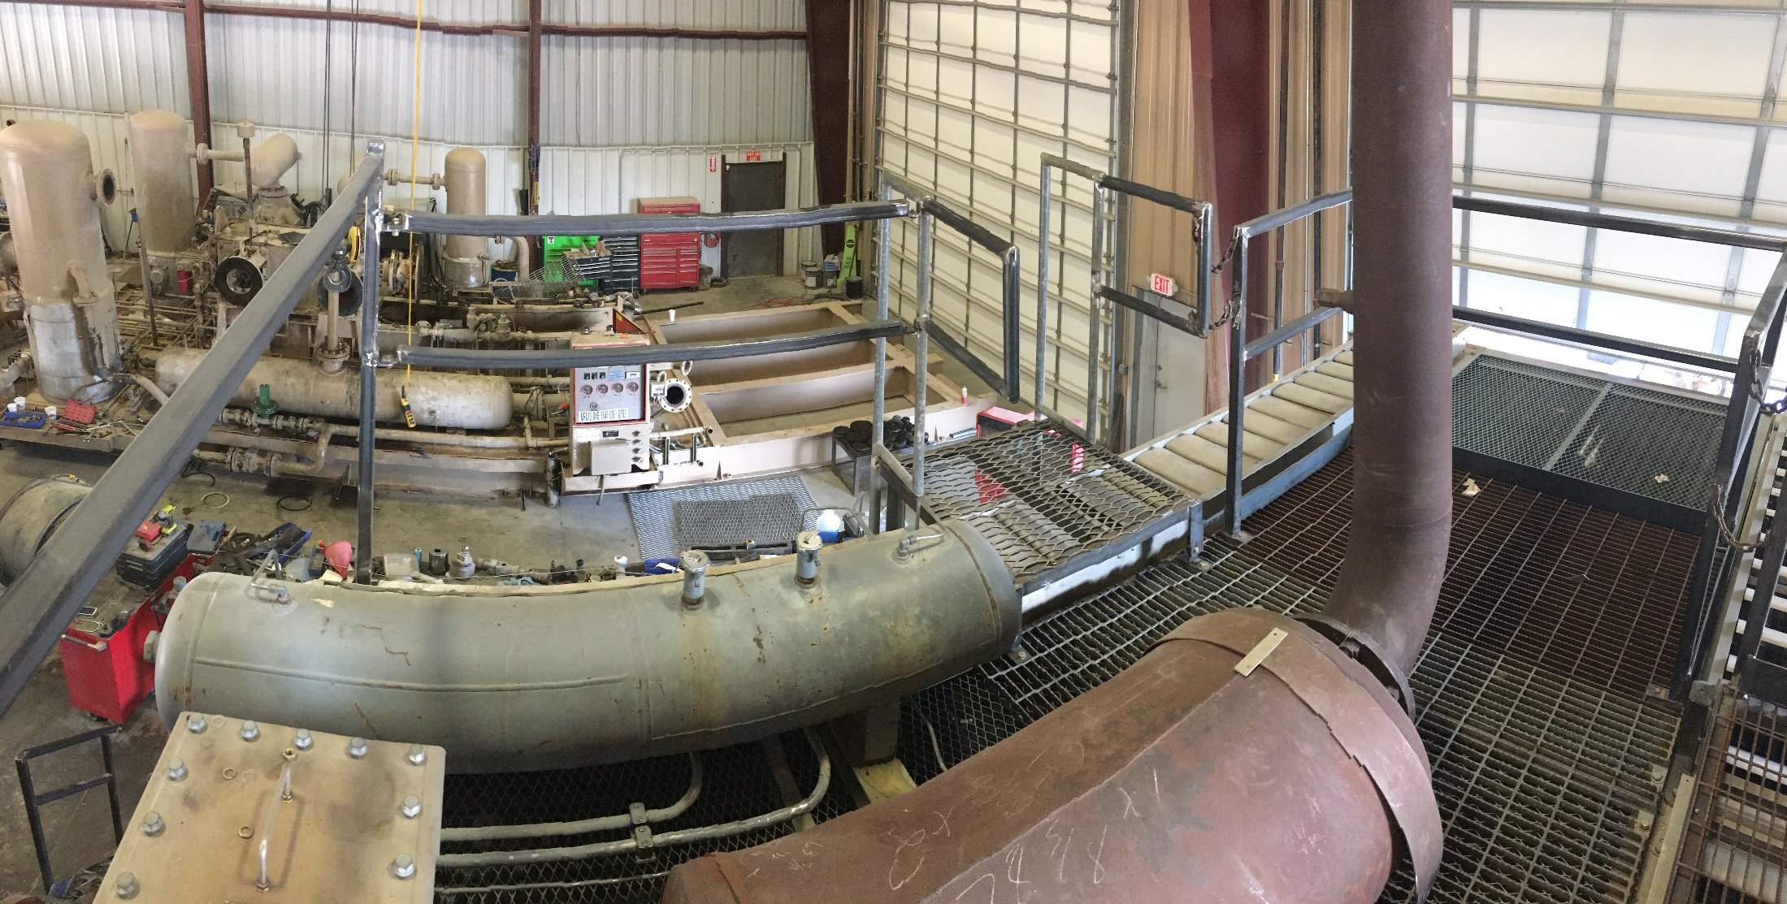
Fully Enclosed Railing Large HP

Slide 29
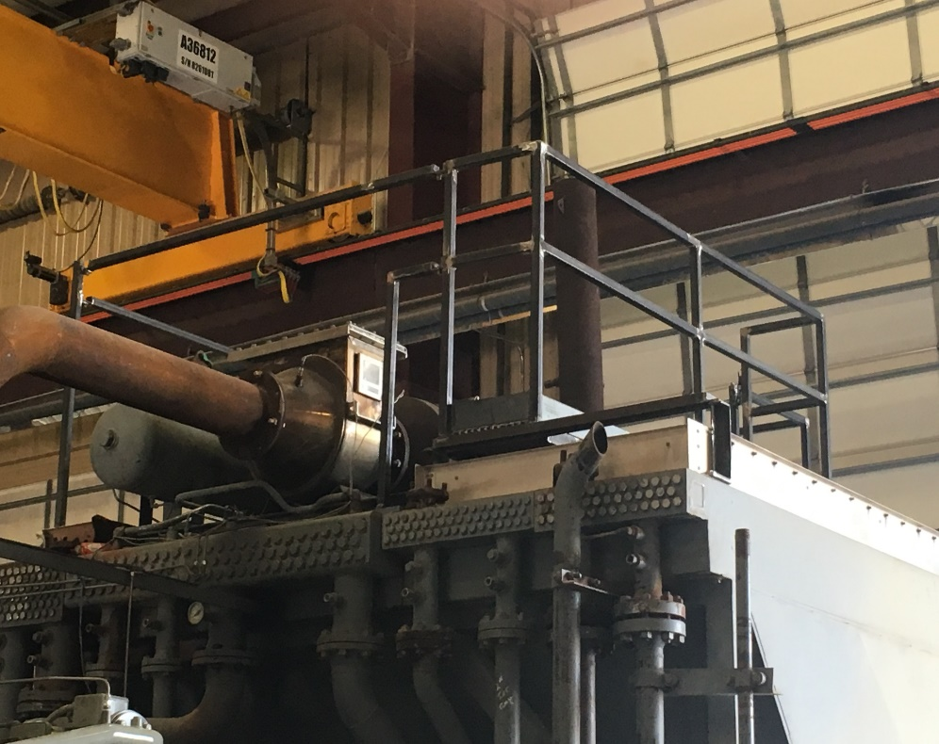
Fully Enclosed Railing Large HP

Slide 30
Fully Enclosed Railing Medium HP

Slide 31
Fully Enclosed Railing Medium HP

Slide 32
Fully Enclosed Railing Small HP

Slide 33
Fully Enclosed Railing Fold-Down Rails

Slide 34
Fully Enclosed Railing All-in-One Removable Basket

Slide 35
Fully Enclosed Railing All-in-One Removable Basket

Slide 36
Fully Enclosed Railing All-in-One Removable Basket

Slide 37
ACCESS TO THE PACKAGE
Same basic WWS practices apply up to and around the unit
Cross-overs installed when needed
Raised grating floors are an excellent work surface

Slide 38
SPECIAL SITUATIONS
In buildings, explore options: cooler outside, higher roof/remove roof, PPE vs. railing, etc. Above all, Plan Ahead!
For trailer-mounts, install platforms/railing when skid height at or above 4 ft.

Slide 39
What about critical units running on location?

Slide 40
Platform With Safety Gate for Coalescing Filters Access
Platform not compliant
Fixed ladder instead of a work surface

Slide 41
Platform With Safety Gate for Coalescing Filters Access
Second one, almost 6’ floor height
First one, below 4’ floor height

Slide 42
PURCHASING PRE-FAB PARTS
Acquiring pre-fab items like platforms and railing systems may help with WWS compliance challenges.
Advantages:
Many products, suppliers, across the country
Cut welding time/materials, lower cost?
Engineered products, OSHA compliant
Disadvantages:
Shipping/inventory/logistics challenges
Possible Hot Work for installation in field
Possible modification needed

Slide 43
PURCHASING PRE-FAB PARTS
Several compressor exhaust/catalyst vendors* now offer an enclosed, removable platform for servicing their products
Numerous vendors offer stairways, railing and grating
*Check out some of these, at the booths in the exhibit hall!

Slide 44
PURCHASING PRE-FAB PARTS
Pre-Fab stairs and railing on CAT 3606 units

Slide 45
PORTABLE LADDERS
Using portable ladders may work in some cases.
Advantages:
Many different types and models
Easily obtained and transported
Rolling stairway-ladders have hand and guard rails
Disadvantages:
Must be maintained in safe condition
Must be properly set up and used
Take up space in service trucks

Slide 46
MECHANICAL LIFTS
Using Aerial Work Platforms (AWP) can be a good choice.
Advantages:
Small, trailer-mounted models available
Large number of rental companies to choose from, no need to cross borders (DOT issues)
Simple to use; in-house training by HSE Instructors
Properly used, a very safe manner of accessing elevated surfaces
Disadvantages:
Balancing rent vs. own, ownership costs
Prior planning for rental
Adequate surface for set-up
Operator training is a MUST, two people on site safer and preferred

Slide 47
MECHANICAL LIFTS

Slide 48
PERSONAL FALL PROTECTION EQUIPMENT AND ANCHOR POINTS
Using personal fall protection is a good solution for unexpected/non-routine tasks. Should not take the place of platforms/railing in frequent maintenance areas.
Advantages:
Large assortment of accessories/options
Lower cost compared to other solutions
Easily trained on, transported, and used

Slide 49
PERSONAL FALL PROTECTION EQUIPMENT AND ANCHOR POINTS
Disadvantages:
Must be properly installed, maintained and used
Anchor points in the right locations
PPE is last choice in hazard control selection

Slide 50
Summary
Slip, Trip and Fall hazards exist for workers servicing field gas compression.
New Federal Regulations and Industry Standards address these.
For various reasons, several challenges must be considered.
Numerous methods exist for upgrading compression to the new WWS standards.
Modifying compressors in the shop is best; options exist for mission-critical units awaiting retrofit.
These hazards can be controlled!

Slide 51
THE END
Teamwork: Common people working together towards a common vision to achieve uncommon results!

